Slide 1
荷電交換反応によるスピン物理
～偏極測定と多重極展開によるスピン双極子モードの研究～
若狭 智嗣（九州大学大学院理学研究院）

Slide 2
Sum Rule and Giant Resonances
L=0
L=1
Giant resonances
  Collective motion
  Common to many-body quantum system
Unique feature of nucleus
  Nucleus consists of nucleons with
    Spin 1/2
    Isospin 1/2
    → 2×2=4 degrees of freedom
Resonance strength depends on
  Number of participating nucleons
  Size of the system
  → Sum-rule depending on
  g.s. properties
Compare GR strength to sum-rule
  Residual interaction (distribution)
  Quark degrees of freedom (quenching)
ΔT=0
ΔS=0
ΔT=0
ΔS=1
p
n
ΔT=1
ΔS=0
ΔT=1
ΔS=1
IVSM(GT)
SDR

Slide 3
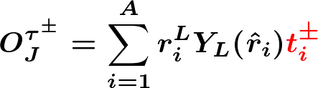
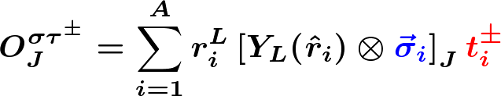

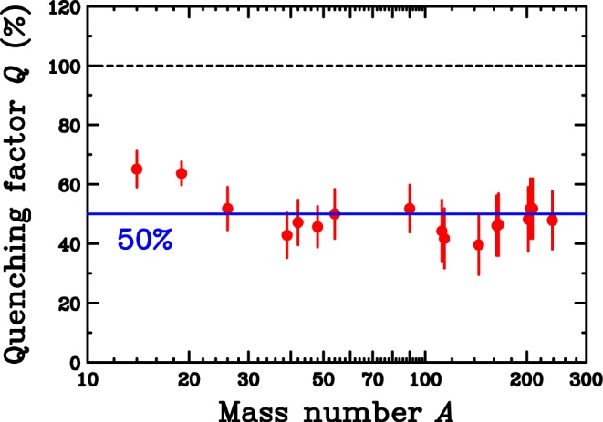
Spin-Isospin Modes and Sum Rule
Spin-isospin transition operators
Model-independent sum-rule
Fermi and GT sum rule
Spin-scalar
Spin-vector
(～S⁻_{J} for N≫Z)
n-radius
p-radius
Fermi
Gamow-Teller
50% quenching
of GTGR
2p2h (Config. Mix.)
Quark (Δ)

Slide 4
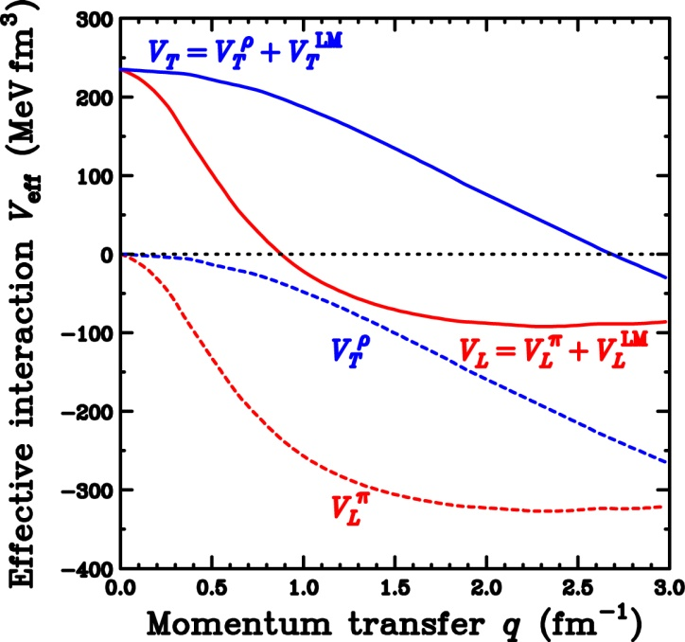



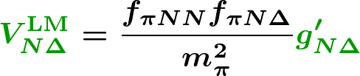
π+ρ+g’ model and Δ Effects
Effective Interaction
π+ρ+g’ model
  Spin-longitudinal
  Spin-transverse
NN(p-h) effective Interaction
Extension to N+Δ system for LM interaction
Longitudinal (π)
Transverse (ρ)
π-exchange
Short-range repulsion
ρ-exchange
g’_{NN} : Strength “distribution”
g’_{NΔ} : Strength “quenching”

Slide 5
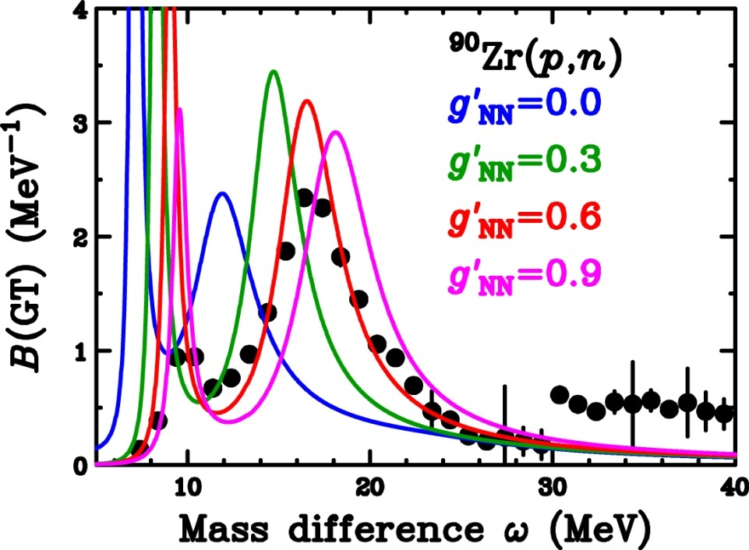

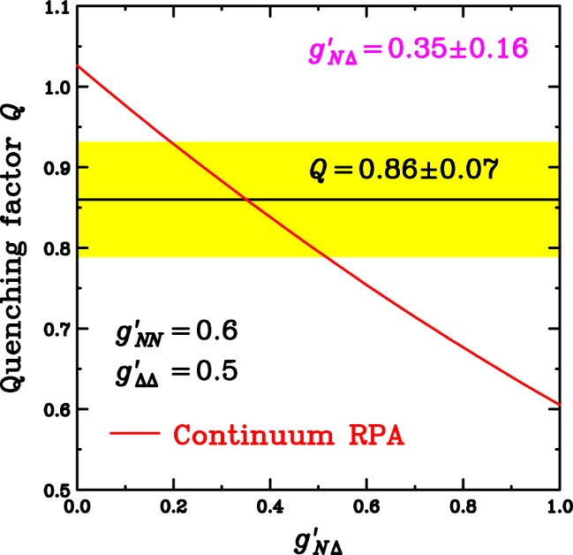

GT Strength and LM Parameters
K.Yako et al., PLB 615(2005)193.
T.W. et al., PRC 72(2005)067303.
g’ dependence on GTGR
  RPA(1p1h) by Ichimura group
  GTGR peak position
    Strongly depends on g’ _{NN}
    Weak g’_{NΔ} dependence
g’_{NΔ} dep. on GT quenching Q
  Q=0.86±0.07
    2p2h effects are dominant
  Q evaluated in RPA
    Strongly depends on g’_{NΔ}
How about other modes (resonances)
  Quenching (?)
  Distribution (Information on residual Int.)
Repulsive
Notes:
Since we obtained the precise distribution of the GT strength and the quenching factor Q, we can determine the Landau-Migdal parameters with these results.
This figure shows the GT beta- strength distribution.
We would like to compare with the RPA calculations with different Landau-Migdal parameter g’NN.
For example, the calculation with g’NN=0 becomes like this.
With increasing g’NN, the peak position of the calculation shifts upward like this.
The calculation with g’NN=0.6 reproduces the exprimental data very well.
If we take g’NN=0.9, then GTGR peak position becomes too high.
Next we change the Landau-Migdal parameter g’ND which specify the coupling between nucleon and Delta.
With increasing g’ND, peak height of the GTGR becomes low, but the positions are almost constant.
Thus from the GTGR peak position, we can determine the g’NN as 0.6 with an uncertainty of about 0.1.
The decrease of the peak height in changing g’ND is due to the GT quenching induced by the coupling between ph and Delta-hole states.
Therefore the g’ND can be determined from the quenching factor Q because this Q is a good measure for the coupling between ph and D-hole states.
The lower figure shows the RPA prediction for the quenching factor Q as a function of g’ND.
With our experimental data of 0.86 +/- 0.07, the g’ND can be determined as 0.35 +/- 0.16.
Please note that the g’ND is significantly smaller than the g’NN, and thus the so-called universality for the Landau-Migdal parameters does not hold.

Slide 6
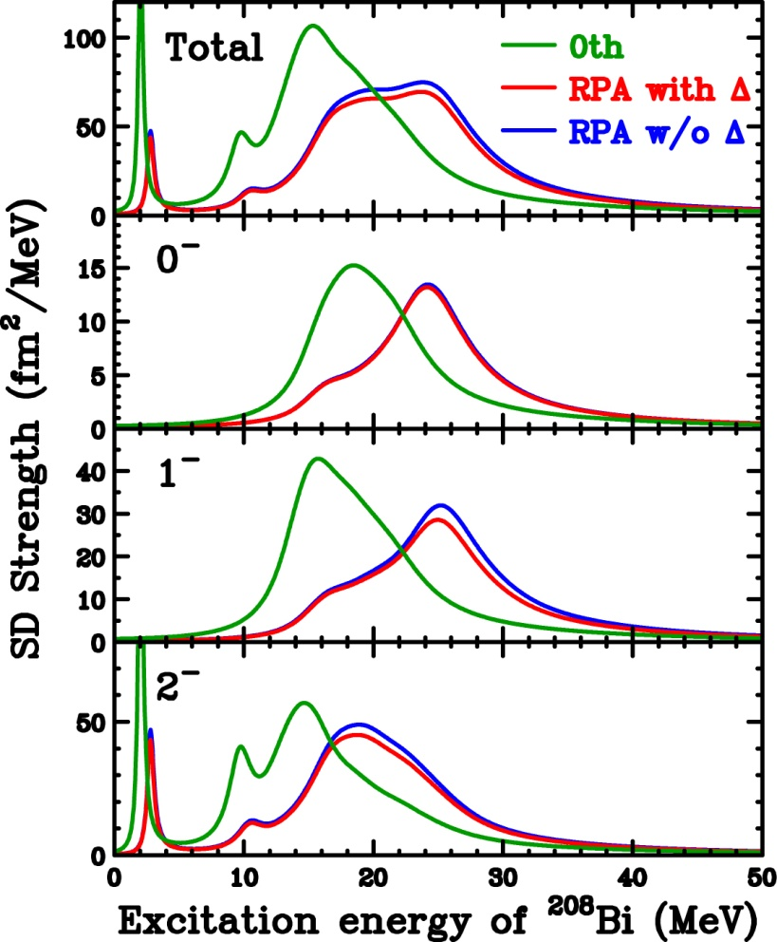
Correlation and Δ Effects on SDR
²⁰⁸Pb(p,n)
SDR in 0th
  E_{x}(2⁻) < E_{x}(1⁻) < E_{x}(0⁻)
  Reflecting shell-structure
    B.E.(j>) > B.E.(j<)
SDR in RPA
  NO free parameters
    Same g’ determined by GT
  E_{x}(2⁻) < E_{x}(1⁻) < E_{x}(0⁻)
    Same as 0th
  Move strengths to higher E_{x}
    Repulsive p-h int.
Δ effects
  Very small in SDR

Slide 7
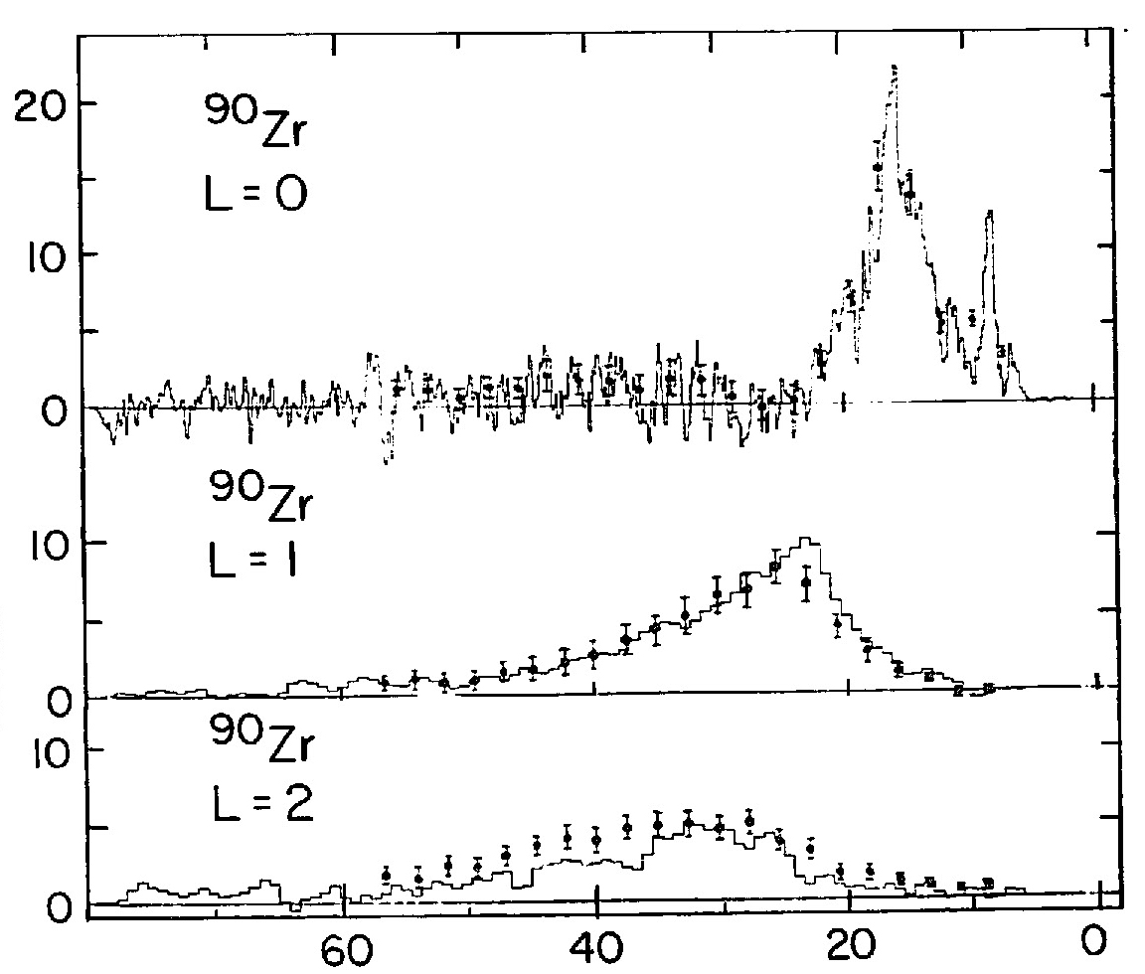
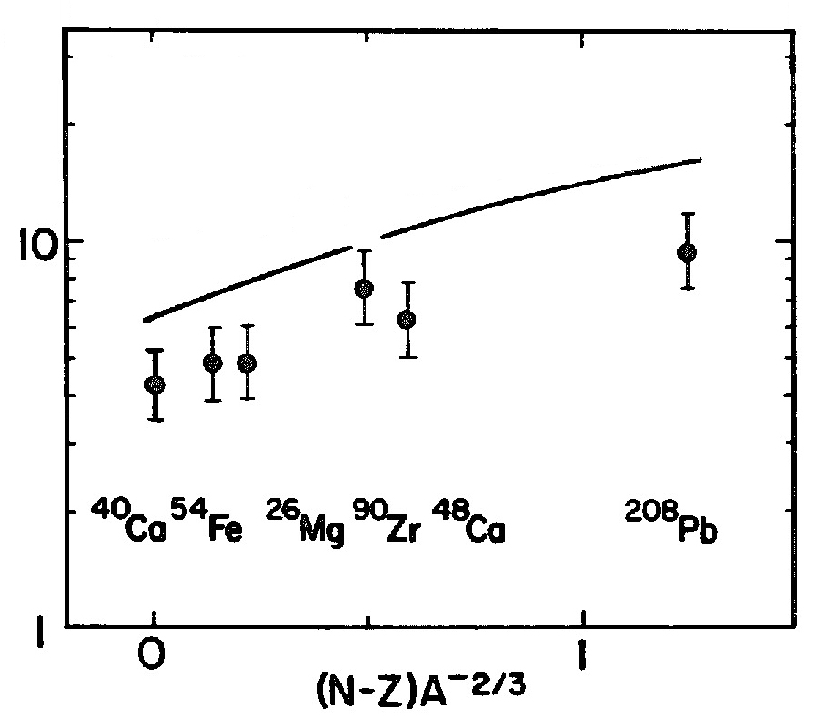
Previous Studies of SDR
Multipole decomposition of ⁹⁰Zr(³He,t) at 900 MeV
  θ=0.25°～4.25°
SDR cross section
  Quenching (～30%) from RPA(1p1h)
    2p2h (Configuration mixing)
    Other mechanism
  Spin-parities could NOT be separated
    Similar angular distributions of 0⁻,1⁻,2⁻
NOT conclusive for quenching
  Rough estimation for distortion effects
  (NOT in full DWIA)
  RPA in g’ only (w/o π/ρ-exchange)
  Angular distributions in (³He,t) are steep
Exp.
Fit
DW calc.
GTR
Cross section (mb/sr/MeV)
SDR
Energy transfer ω (MeV)
Theory in RPA
Cross section (mb/sr)
Quenching

Slide 8
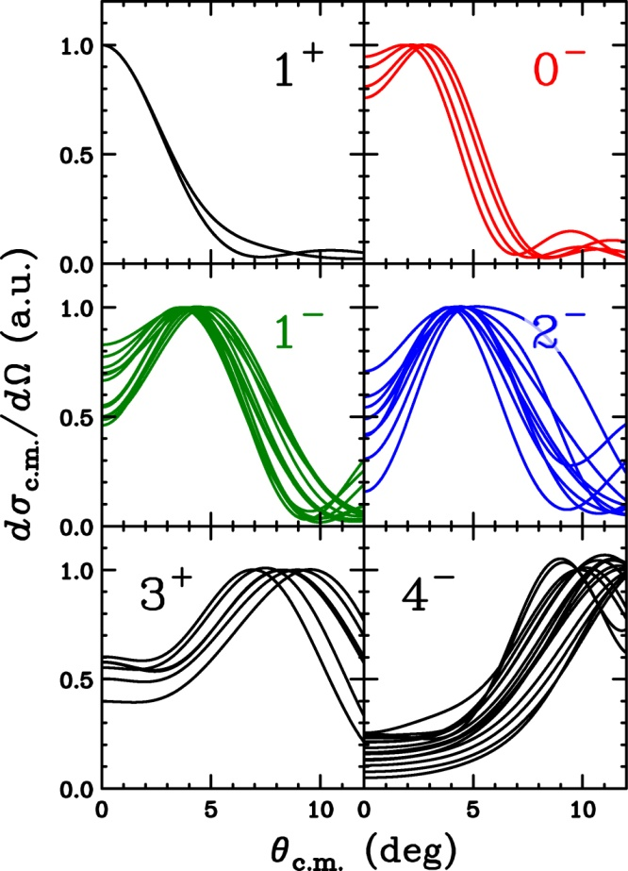
MD Analysis for SD
－Difficulties and Solutions－
Multipole Decomposition Analysis (MDA)
  L-dependence of angular distributions
    Insensitive to J^{π}
MDA for GT
  0⁺ and 1⁺ for L=0
    0⁺ strength → IAS (Easily removed)
MDA for SD
  0⁻, 1⁻, 2⁻ for L=1
    Separation is difficult with σ
  GDR and SDR for 1⁻ could not be separated
Polarization transfer D_{ij} for SD
 | D_{NN}(4.0°) | D_{LL}(4.0°)
0⁻ (SDR) | -1.00 | -1.00
2⁻ (SDR) | -0.17 | -0.41
1⁻ (SDR) | +0.19 | -0.16
1⁻ (GDR) | +0.96 | +0.95
MDA with D_{ij}
Separate 0⁻,1⁻,2⁻
Separate GDR and SDR

Slide 9
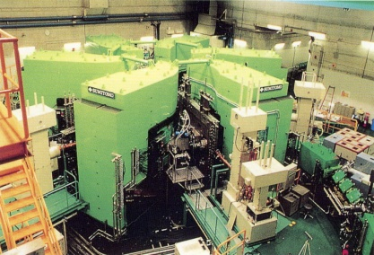
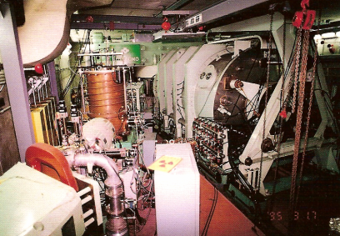

Experiment at RCNP
Thanks to M. Dozono
Beam Swinger System
Ring Cyclotron
AVF Cyclotron
BLP1 & BLP2
NPOL2
SOL1 & SOL2
Beam swinger
  Cover θ=0°～13.4°
Measured data (33 data sets)
  σ : 13 angles
  A_{y} : 12 angles
  D_{NN} : 4 angles(0,4,7,10deg)
  D_{LL} : 1 angle(0deg)
  P : 3 angles(4,7,10deg)
295 MeV Polarized protons
  Predominantly excite GT and SDR
Beam polarization
  Control with 2-sets of solenoids
  Measure with 2-sets of BLP by p-p
Notes:
The experiment was performed at the Research Center for Nuclear Physics, Osaka.
The polarized proton beam was accelerated up to 200 MeV by using AVF and ring cyclotrons.
The polarization axis was controlled by using two sets of superconducting solenoild magnet for the complete polarization transfer measurement.
The neutron from the (p,n) reaction was measured by using this 100 m TOF tunnel, and they were detected by the neutron polarimeter NPOL3.

Slide 10
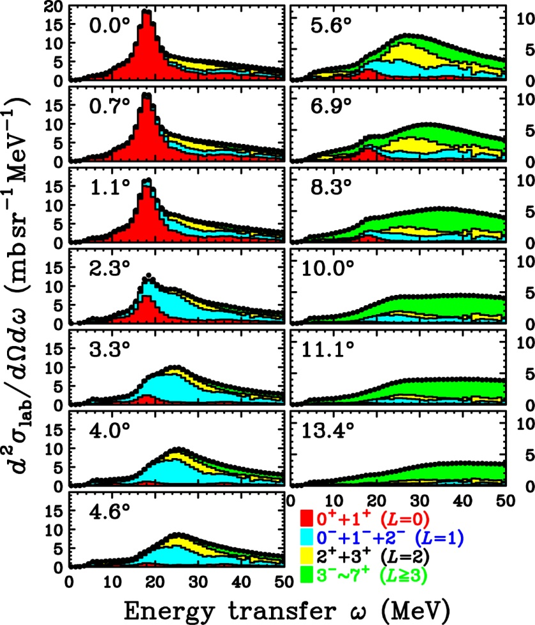
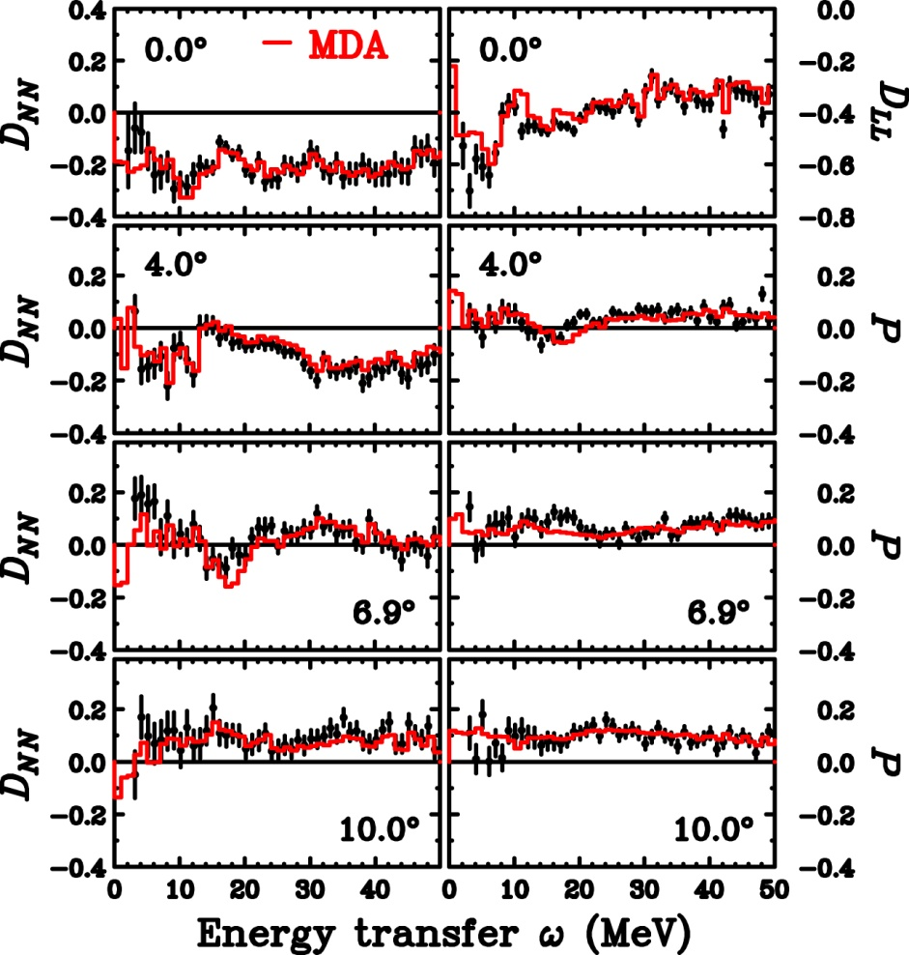
Results of MDA
～First MDA with Polarization Data～
MDA (up to 7⁺(L=6))
  Both cross section and polarization data are well reproduced
  At 0°: Significant L=0 (GT+IVSM) up to 50 MeV
  At 4°: Significant L=1 (SDR) around 20 and 35 MeV (2p2h?)

Slide 11
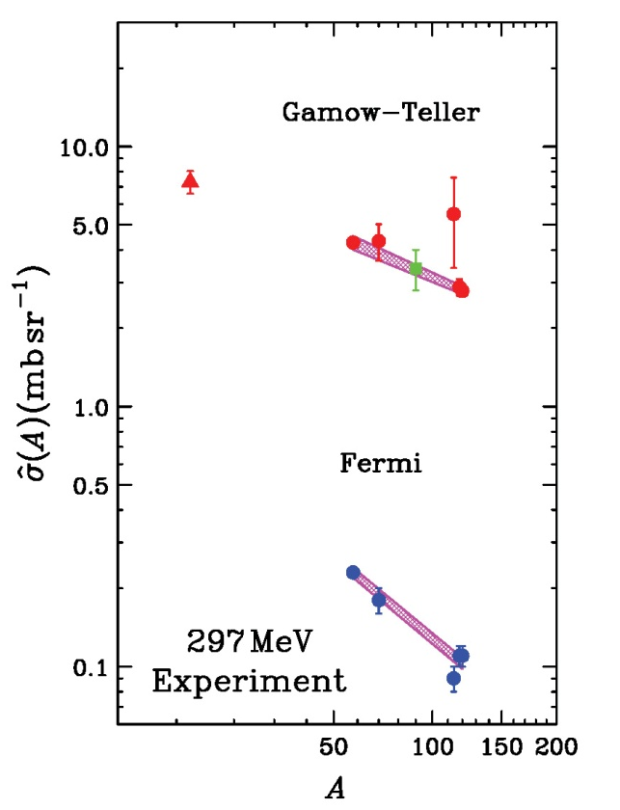
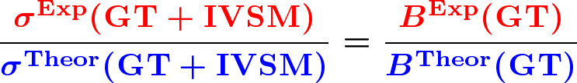

Gamow-Teller Strength B(GT)
MDA could not separate GT from IVSM
  Assumption
    Proportionality between GT/IVSM strength and cross section
    Weak interference between GT and IVSM
    Similar quenching effects on IVSM
  Reliability for theoretical calculations
MDA
GT unit c.s.
Theoretical calculations are reliable
→ Systematic uncertainty of B(GT) ～ 10%
M.Sasano et al.,
PRC 79, 024602 (2009)

Slide 12
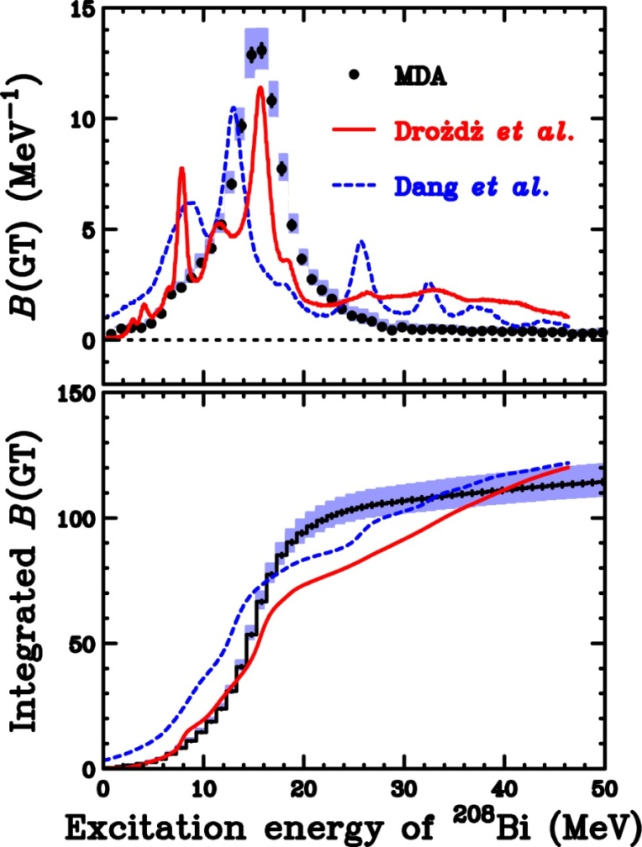

GT Strength B(GT)
～Comparison with 2p2h calc.～
Experimental B(GT)
  Strength up to 50 MeV
  Not significant compared with ⁹⁰Nb
  Configuration mixing is dominant
    Quark (Δ) effect is small
  Consistent with Q=0.86 for ⁹⁰Nb
    S⁺(GT) is expected to be small
Theoretical calc. with 2p2h
  S⁻(GT) is consistent
  Different B(GT) distributions
    Exp: Concentrate in GR region
    Theory: Significant spread
S.Drozdz et al., PLB 189, 271(1987)
N.D.Dang et al.,PRL 79,1638(1997)
Further studies are required for conclusions

Slide 13
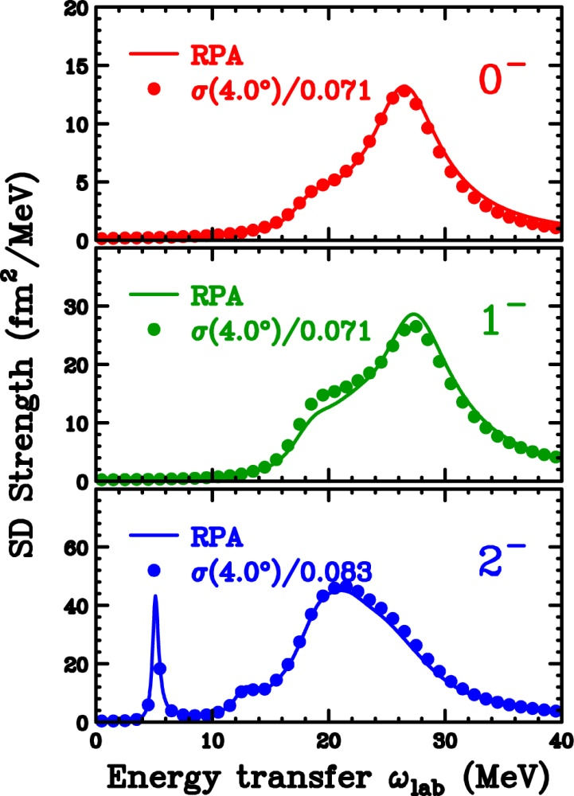


SD Unit Cross Section
C. Gaarde et al., NPA 369, 258 (1981)
K. Yako et al., PRC 74, 051303(R)(2006)
Relation between SD cross section and SD strength B(SD)
  Proportionality ansatz
    Proportionality : ～10%
  Differences from constant unit c.s.
    q-dep. (q is a function of ω)
    Structure (radial W.F.)
    Tensor int. (structure dep.)
Unit c.s. depends on DWIA inputs
  Optical potential, etc.
    Uncertainty : ～10%
MDA
Unit c.s.
Strength
based on DWIA+RPA calc.

Slide 14
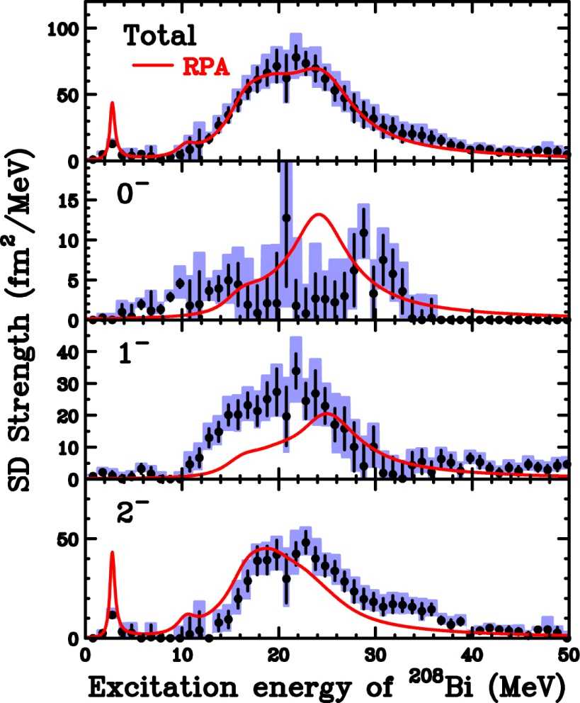
SD Strength Distributions
～Comparison with RPA～
Experimental B(SD)
  Asymmetric single peak for 1⁻ & 2⁻
    Tail to higher E_{x} up to 40 MeV
  Fragmented 0⁻ strength
Theoretical calc. in RPA
  Phenomenological spreading width
    Effective inclusion of 2p2h
    (in part)
  Strength distribution
    Total strength is consistent
    0⁻ strength is severely fragmented
  Sequence of SDR peak
    Exp: E_{x}(2⁻) ～ E_{x}(1⁻) ～ E_{x}(0⁻)
    Theory: E_{x}(2⁻) < E_{x}(1⁻) < E_{x}(0⁻)
Comment on tensor correlations
  Repulsive effect on 1⁻ : N.G. (attractive effect ? )

Slide 15
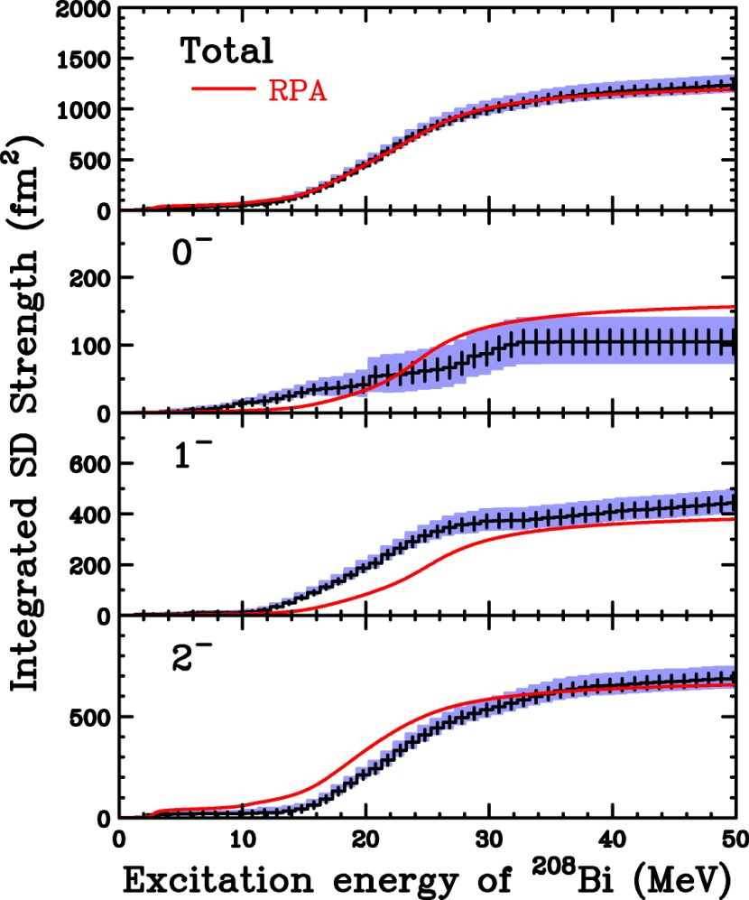
Integrated SD Strength
～Comparison with RPA～
Experimental B(SD) from MDA
  Uncertainties
    : Statistical uncertainty
    : MDA uncertainty
    ～10% systematic uncertainty
    from σ_{SD}
Comparison with RPA
  0⁻ : Slightly small (NOT significant)
  1⁻ : Consistent (Softened)
  2⁻ : Consistent (Hardened)
  Total : Consistent (Similar distribution)
SD strengths are NOT quenched
SD distribution of each J^{π} is different from theoretical predictions
J^{π} decomposition in MDA with polarization data is successful

Slide 16
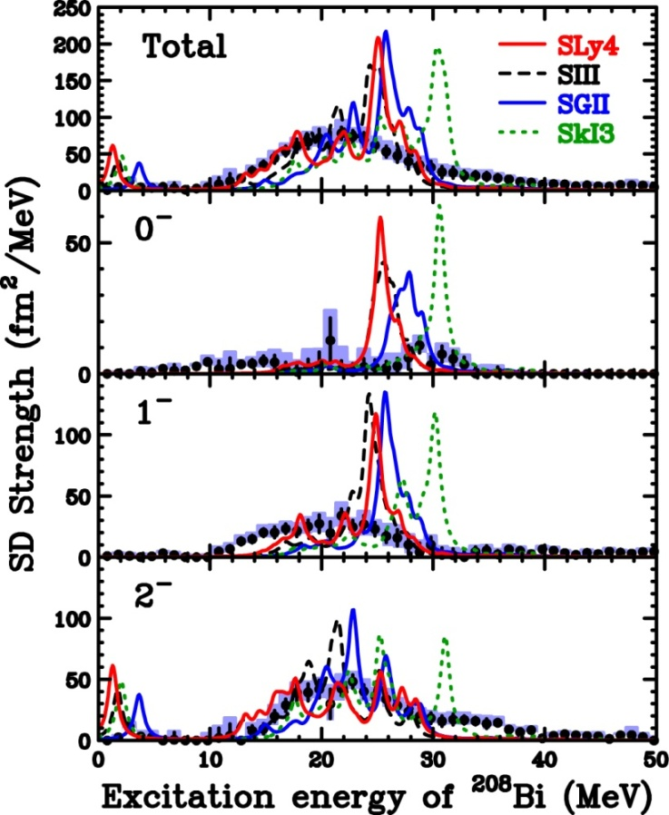
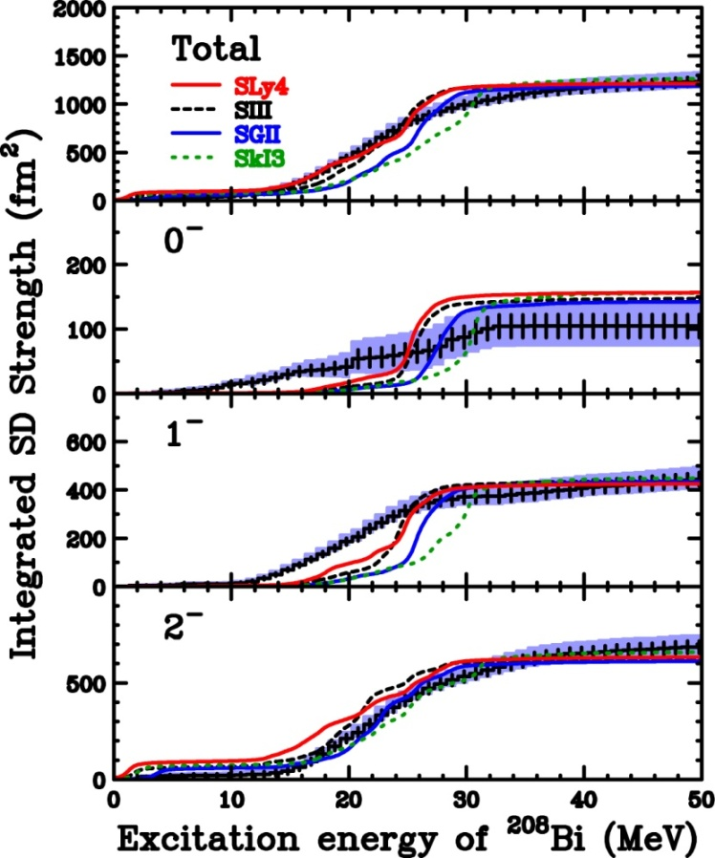
Comparison with HF+RPA
HF+RPA calculations by Sagawa-san’s group
  Skyrme interaction: SLy4, SIII,SGII,SkI3
    0⁻ and 1⁻ strengths are smeared/fragmented compared with calc.
    1⁻ strength is significantly softened
    Integrated strengths (each J^{π},Total) are consistent

Slide 17
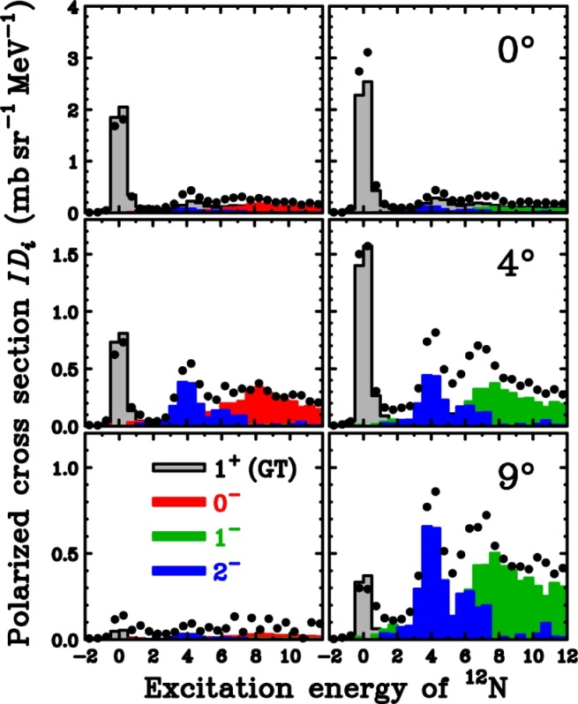
Summary and Future Perspective
First attempt to perform MDA with polarization data
  Successful separation of SDR into each J^{π} component
Information on SD strengths
  SD strengths are NOT quenched
    0⁻ strength : Fragmented
    1⁻ strength : Softened
    (Inconsistent with tensor effects)
    2⁻ strength : Roughly consistent
Perspective (In Progress)
  MDA with “complete” polarization data
    0⁻,1⁻,2⁻ Separation becomes more reliable
    We can check the reliability of MDA
  RCNP-E317 : ¹²C(p,n)¹²N
    Complete polarization data at 0°,2°,4°6°,9°,12°(6 angles)
M. Dozono (Doctor work)
Spin-longitudinal
Spin-transverse
1⁺
2⁻
2⁻
0⁻
2⁻
1⁻
2⁻
Establish method of J^{π} decomposition in continuum by polarization data

Slide 18
Backup

Slide 19
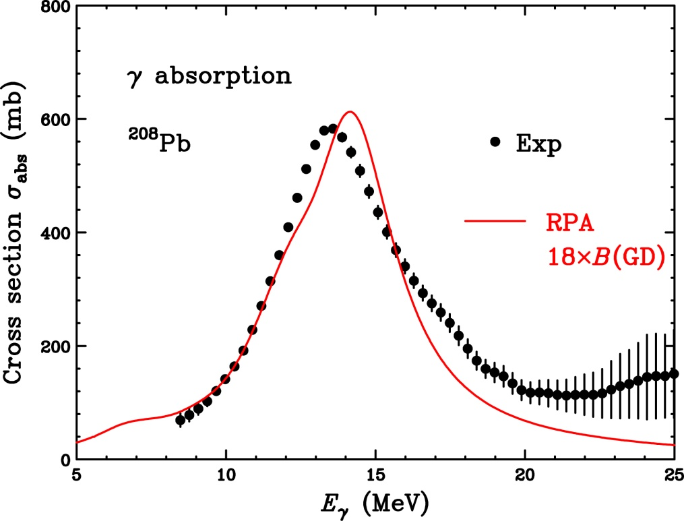
Comment on GDR
Experimental GDR strength
  γ absorption
    GDR is dominant
  E_{x} ～ 14 MeV
  Γ ～ 4 MeV
RPA calculation
  NO free parameter
    f is determined by IAS
  Phenomenological
  spreading width
  (p,n) and (γ,n) difference is
  properly taken into account
  Proportionality ansatz
    σ_{abs} = 18×B(GDR)
S.N.Belyaev et al., Yad. Phys. 55, 289 (1992).
GDR strength is well described by RPA
→In MDA, GDR (non-spin) component can be fixed to RPA(γ-abs. data)

Slide 20
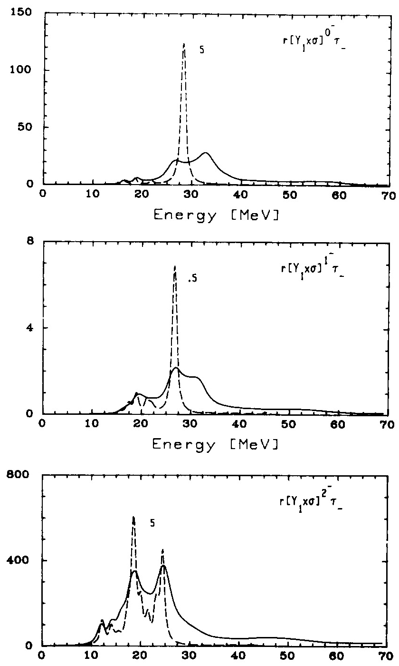
Previous Studies of SDR
Theoretical predictions
  2p2h effects in 2nd-order RPA (SRPA)
    Smear out RPA distributions
    Move strengths to higher energies
  Smearing effects are relatively small in 2-
    2- has large config. compared with 0- and 1-
    2- strength is fragmented in RPA(1p1h)
    0- and 1- strengths → 2p2h effects

Slide 21
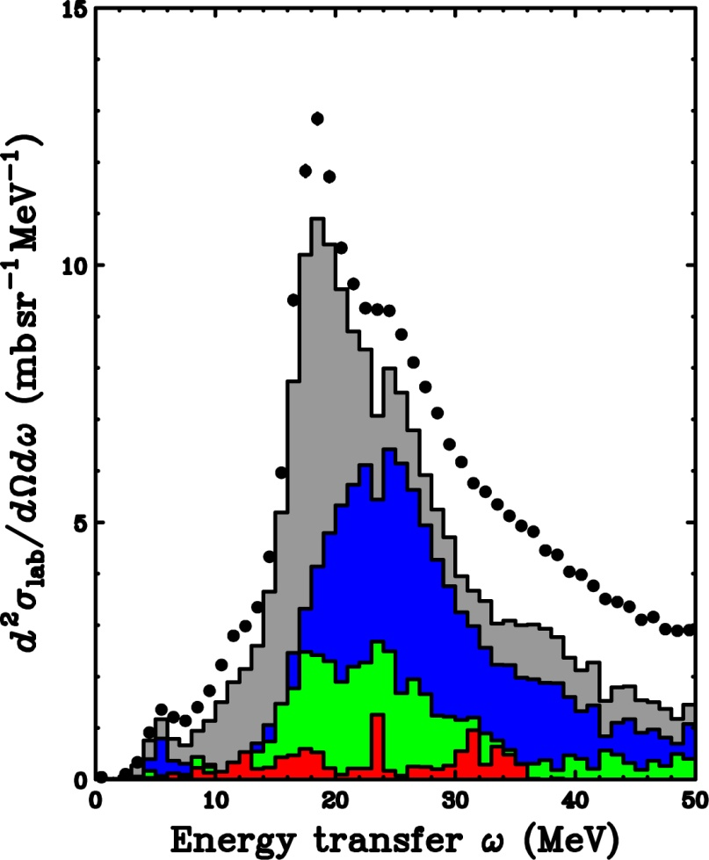
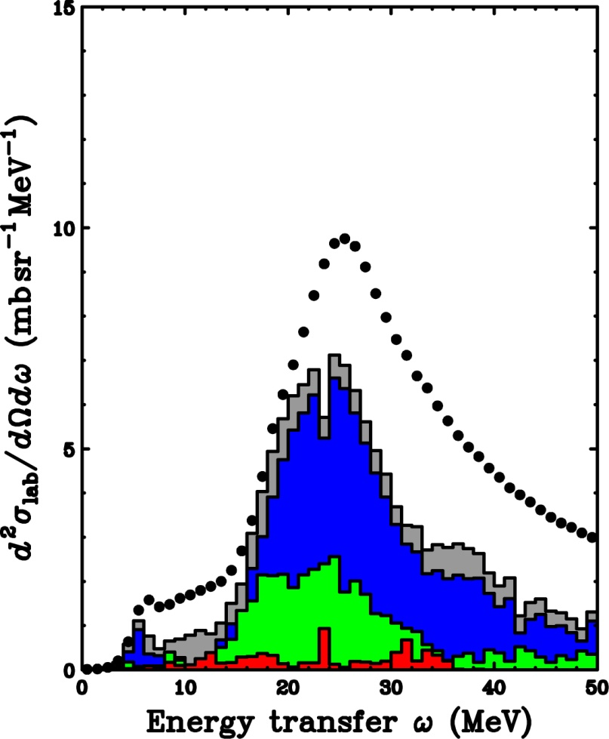
Results of MDA for ²⁰⁸Pb(p,n)
GTGR
2.3°
4.0°
1⁺(GT)
SDR
SDR
0⁻(SDR)
1⁻(SDR)
2⁻(SDR)

