Slide 1
GT and SDR Studies for Stable Nuclei and Perspective for Unstable Nuclei
Tomotsugu Wakasa
Department of Physics, Kyushu University

Slide 2
Contents
GT study for ⁹⁰Zr
Unified understanding of spin-isospin responses
π+ρ+g’ model
Two free parameters: g’_{NN} and g’_{NΔ}
Peak position → g’_{NN} (short-range repulsion in NN)
Strength (quenching) → g’_{NΔ} (short-range repulsion in NΔ)
No free parameter in π+ρ+g’ model
GT/SD study for ²⁰⁸Pb
Comparison with predictions in π+ρ+g’ model
Quantitative reproduction by π+ρ+g’ model
Perspective for unstable nuclei
Can we deduce GT/SD strengths ?
Without performing multipole decomposition
Without normalizing to beta-decay strengths
Predictions for Zr and O isotopes in π+ρ+g’ model

Slide 3
Sum Rule and Giant Resonances
L=0
L=1
Giant resonances
Collective motion
Common to many-body quantum system
Unique feature of nucleus
Nucleus consists of nucleons with
Spin 1/2
Isospin 1/2 → 2×2=4 degrees of freedom
Resonance strength depends on
Number of participating nucleons
Size of the system → Sum-rule depending on g.s. properties
Compare GR strength to sum-rule
Residual interaction (distribution)
Quark degrees of freedom (quenching)
ΔT=0
ΔS=0
ΔT=0
ΔS=1
p
n
ΔT=1
ΔS=0
ΔT=1
ΔS=1
IVSM(GT)
SDR

Slide 4
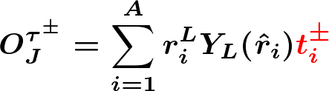
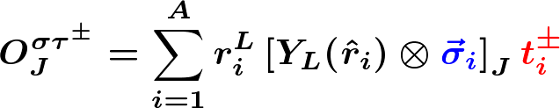

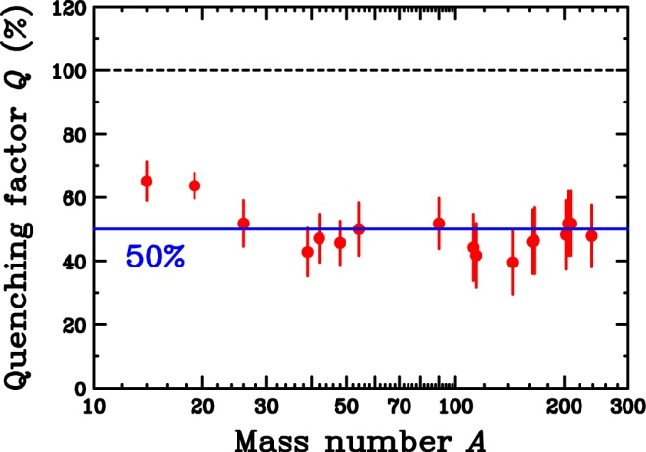
Spin-Isospin Modes and Sum Rule
Spin-isospin transition operators
Model-independent sum-rule
Fermi and GT sum rule
Spin-scalar
Spin-vector
(～S⁻_{J} for N≫Z)
n-radius
p-radius
Fermi
Gamow-Teller
50% quenching of GTGR
2p2h (Config. Mix.)
Quark (Δ)

Slide 5
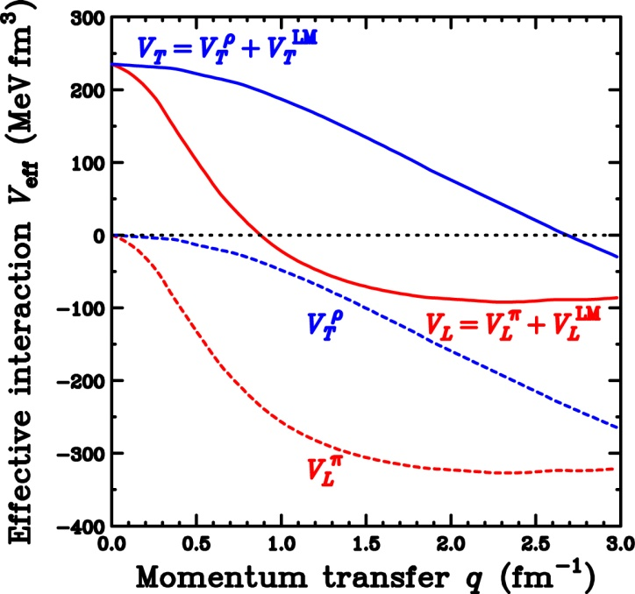



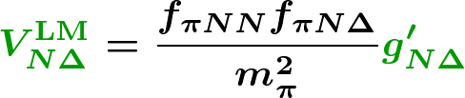
π+ρ+g’ model and Δ Effects
Effective Interaction
π+ρ+g’ model
Spin-longitudinal
Spin-transverse
NN(p-h) effective Interaction
Extension to N+Δ system for LM interaction
Longitudinal (π)
Transverse (ρ)
π-exchange
Short-range repulsion
ρ-exchange
g’_{NN} : Strength “distribution”
g’_{NΔ} : Strength “quenching”

Slide 6
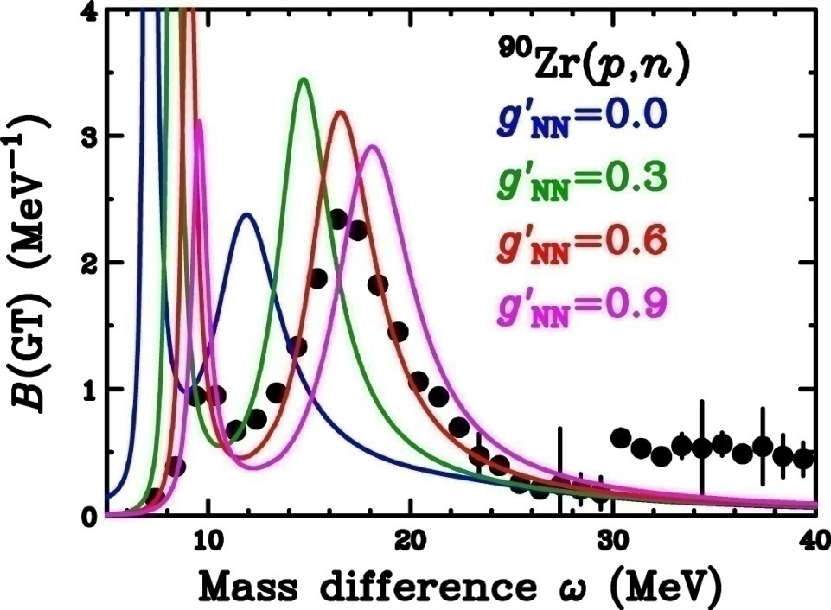

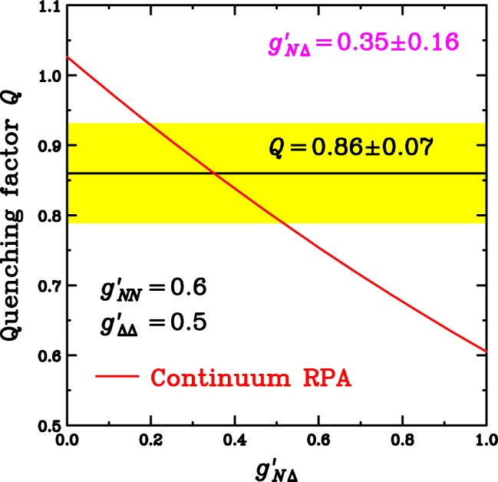

GT Strength and LM Parameters
K.Yako et al., PLB 615(2005)193.
T.W. et al., PRC 72(2005)067303.
g’ dependence on GTGR
RPA(1p1h) by Ichimura group
GTGR peak position
Strongly depends on g’ _{NN}
Weak g’_{NΔ} dependence
g’_{NΔ} dep. on GT quenching Q
Q=0.86±0.07
2p2h effects are dominant
Q evaluated in RPA
Strongly depends on g’_{NΔ}
How about other modes (resonances)
Quenching (?)
Distribution (Information on residual Int.)
Repulsive
Notes:
Since we obtained the precise distribution of the GT strength and the quenching factor Q, we can determine the Landau-Migdal parameters with these results.
This figure shows the GT beta- strength distribution.
We would like to compare with the RPA calculations with different Landau-Migdal parameter g’NN.
For example, the calculation with g’NN=0 becomes like this.
With increasing g’NN, the peak position of the calculation shifts upward like this.
The calculation with g’NN=0.6 reproduces the exprimental data very well.
If we take g’NN=0.9, then GTGR peak position becomes too high.
Next we change the Landau-Migdal parameter g’ND which specify the coupling between nucleon and Delta.
With increasing g’ND, peak height of the GTGR becomes low, but the positions are almost constant.
Thus from the GTGR peak position, we can determine the g’NN as 0.6 with an uncertainty of about 0.1.
The decrease of the peak height in changing g’ND is due to the GT quenching induced by the coupling between ph and Delta-hole states.
Therefore the g’ND can be determined from the quenching factor Q because this Q is a good measure for the coupling between ph and D-hole states.
The lower figure shows the RPA prediction for the quenching factor Q as a function of g’ND.
With our experimental data of 0.86 +/- 0.07, the g’ND can be determined as 0.35 +/- 0.16.
Please note that the g’ND is significantly smaller than the g’NN, and thus the so-called universality for the Landau-Migdal parameters does not hold.

Slide 7
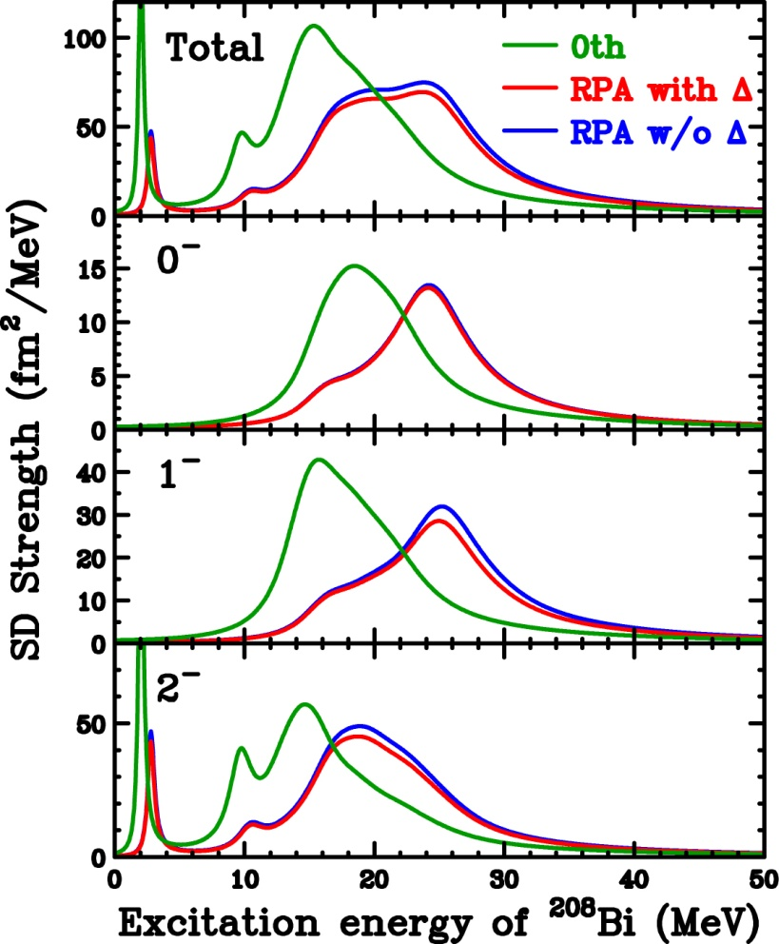
Correlation and Δ Effects on SDR
²⁰⁸Pb(p,n)
SDR in 0th
E_{x}(2⁻) < E_{x}(1⁻) < E_{x}(0⁻)
Reflecting shell-structure
B.E.(j>) > B.E.(j<)
SDR in RPA
NO free parameters
Same g’ determined by GT
E_{x}(2⁻) < E_{x}(1⁻) < E_{x}(0⁻)
Same as 0th
Move strengths to higher E_{x}
Repulsive p-h int.
Δ effects
Very small in SDR

Slide 8
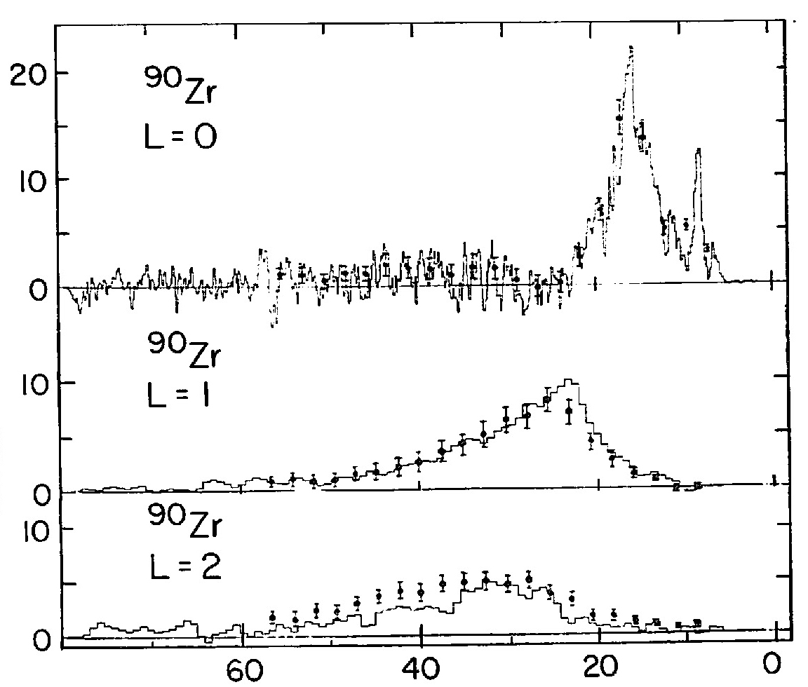
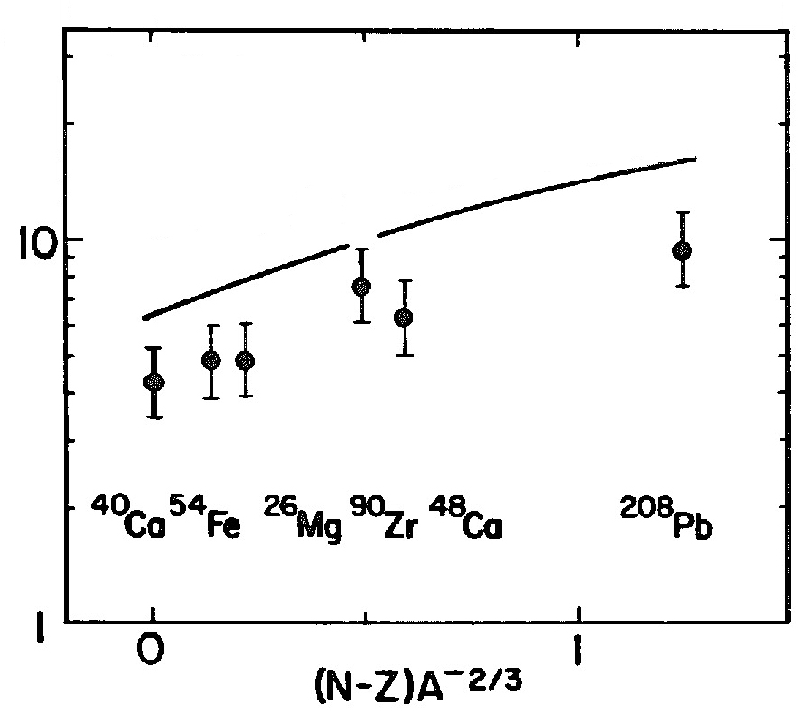
Previous Studies of SDR
Multipole decomposition of ⁹⁰Zr(³He,t) at 900 MeV
θ=0.25°～4.25°
SDR cross section
Quenching (～30%) from RPA(1p1h)
2p2h (Configuration mixing)
Other mechanism
Spin-parities could NOT be separated
Similar angular distributions of 0⁻,1⁻,2⁻
NOT conclusive for quenching
Rough estimation for distortion effects (NOT in full DWIA)
RPA in g’ only (w/o π/ρ-exchange)
Angular distributions in (³He,t) are steep
Exp.
Fit
DW calc.
GTR
Cross section (mb/sr/MeV)
SDR
Energy transfer ω (MeV)
Theory in RPA
Cross section (mb/sr)
Quenching

Slide 9
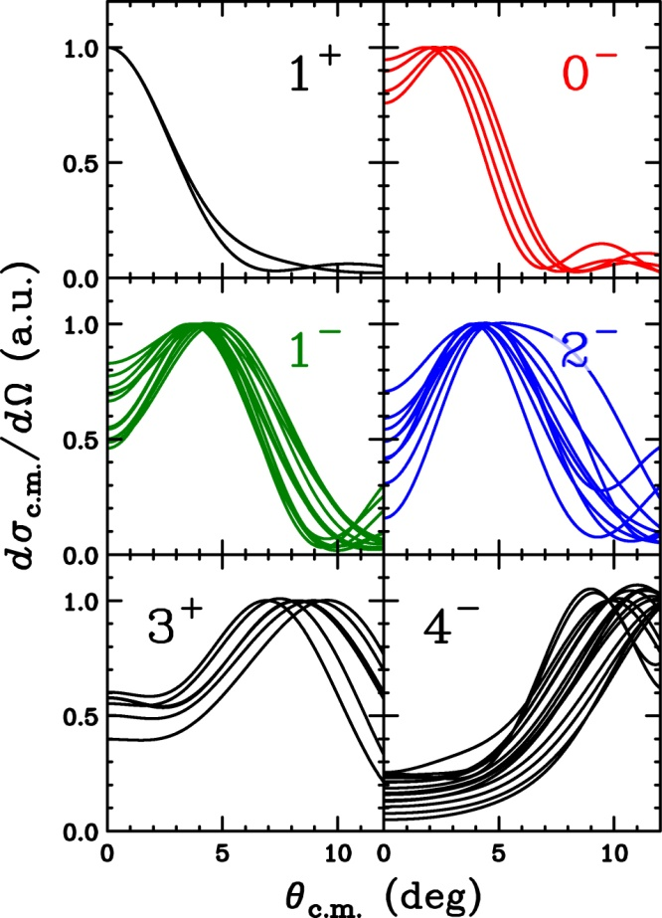
MD Analysis for SD －Difficulties and Solutions－
Multipole Decomposition Analysis (MDA)
L-dependence of angular distributions
Insensitive to J^{π}
MDA for GT
0⁺ and 1⁺ for L=0
0⁺ strength → IAS (Easily removed)
MDA for SD
0⁻, 1⁻, 2⁻ for L=1
Separation is difficult with σ
GDR and SDR for 1⁻ could not be separated
Polarization transfer D_{ij} for SD
 | D_{NN}(4.0°) | D_{LL}(4.0°)
0⁻ (SDR) | -1.00 | -1.00
2⁻ (SDR) | -0.17 | -0.41
1⁻ (SDR) | +0.19 | -0.16
1⁻ (GDR) | +0.96 | +0.95
MDA with D_{ij}
Separate 0⁻,1⁻,2⁻
Separate GDR and SDR

Slide 10
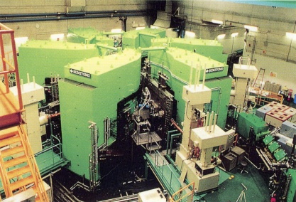
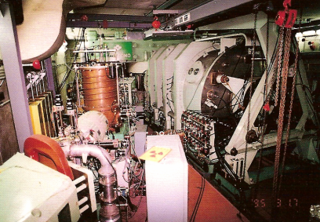

Experiment at RCNP
Thanks to M. Dozono
Beam Swinger System
Ring Cyclotron
AVF Cyclotron
BLP1 & BLP2
NPOL2
SOL1 & SOL2
Beam swinger
Cover θ=0°～13.4°
Measured data (33 data sets)
σ : 13 angles
A_{y} : 12 angles
D_{NN} : 4 angles(0,4,7,10deg)
D_{LL} : 1 angle(0deg)
P : 3 angles(4,7,10deg)
295 MeV Polarized protons
Predominantly excite GT and SDR
Beam polarization
Control with 2-sets of solenoids
Measure with 2-sets of BLP by p-p
Notes:
The experiment was performed at the Research Center for Nuclear Physics, Osaka.
The polarized proton beam was accelerated up to 200 MeV by using AVF and ring cyclotrons.
The polarization axis was controlled by using two sets of superconducting solenoild magnet for the complete polarization transfer measurement.
The neutron from the (p,n) reaction was measured by using this 100 m TOF tunnel, and they were detected by the neutron polarimeter NPOL3.

Slide 11
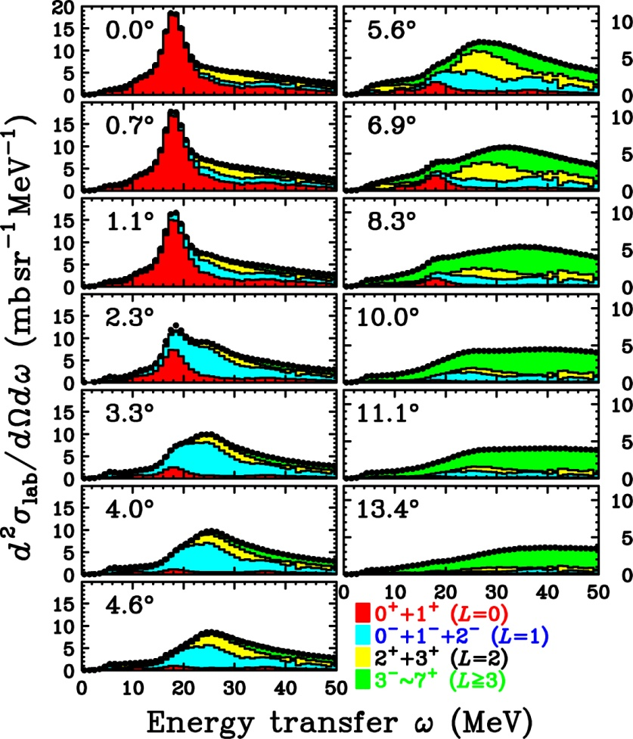
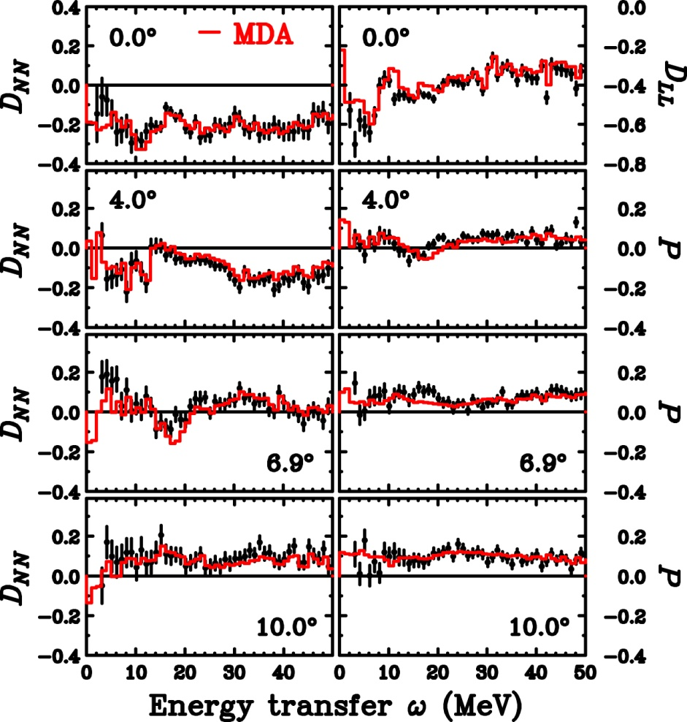
Results of MDA ～First MDA with Polarization Data～
MDA (up to 7⁺(L=6))
Both cross section and polarization data are well reproduced
At 0°: Significant L=0 (GT+IVSM) up to 50 MeV
At 4°: Significant L=1 (SDR) around 20 and 35 MeV (2p2h?)

Slide 12
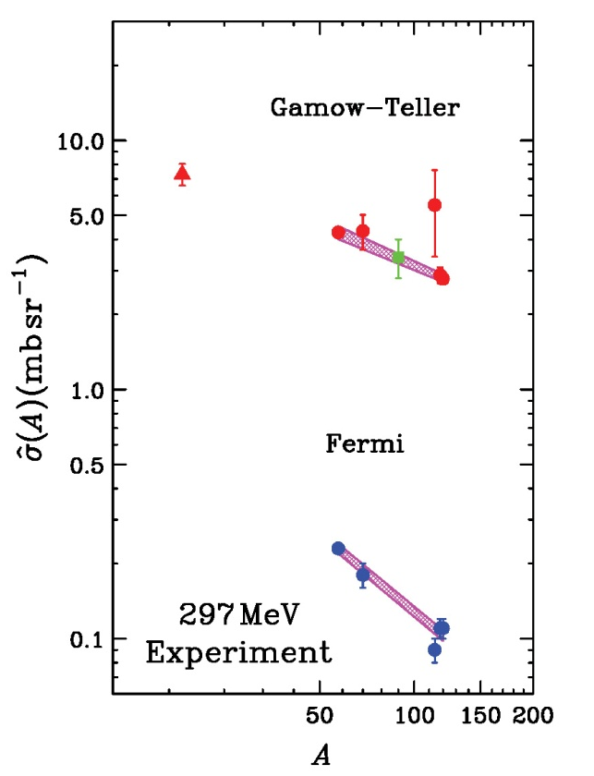
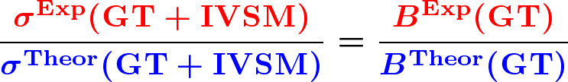

Gamow-Teller Strength B(GT)
MDA could not separate GT from IVSM
Assumption
Proportionality between GT/IVSM strength and cross section
Weak interference between GT and IVSM
Similar quenching effects on IVSM
Reliability for theoretical calculations
MDA
GT unit c.s.
Theoretical calculations are reliable
→ Systematic uncertainty of B(GT) ～ 10%
M.Sasano et al.,
PRC 79, 024602 (2009)

Slide 13
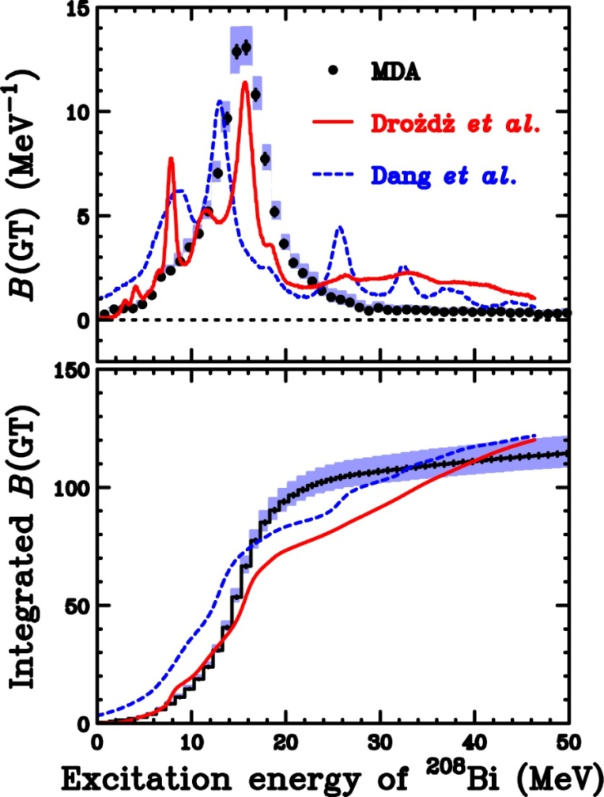

GT Strength B(GT) ～Comparison with 2p2h calc.～
Experimental B(GT)
Strength up to 50 MeV
Not significant compared with ⁹⁰Nb
Configuration mixing is dominant
Quark (Δ) effect is small
Consistent with Q=0.86 for ⁹⁰Nb
S⁺(GT) is expected to be small
Theoretical calc. with 2p2h
S⁻(GT) is consistent
Different B(GT) distributions
Exp: Concentrate in GR region
Theory: Significant spread
S.Drozdz et al., PLB 189, 271(1987)
N.D.Dang et al.,PRL 79,1638(1997)
Further studies are required for conclusions

Slide 14
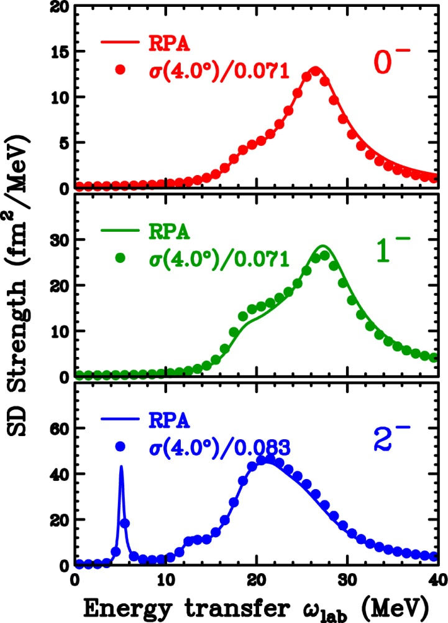


SD Unit Cross Section
C. Gaarde et al., NPA 369, 258 (1981)
K. Yako et al., PRC 74, 051303(R)(2006)
Relation between SD cross section and SD strength B(SD)
Proportionality ansatz
Proportionality : ～10%
Differences from constant unit c.s.
q-dep. (q is a function of ω)
Structure (radial W.F.)
Tensor int. (structure dep.)
Unit c.s. depends on DWIA inputs
Optical potential, etc.
Uncertainty : ～10%
MDA
Unit c.s.
Strength
based on DWIA+RPA calc.

Slide 15
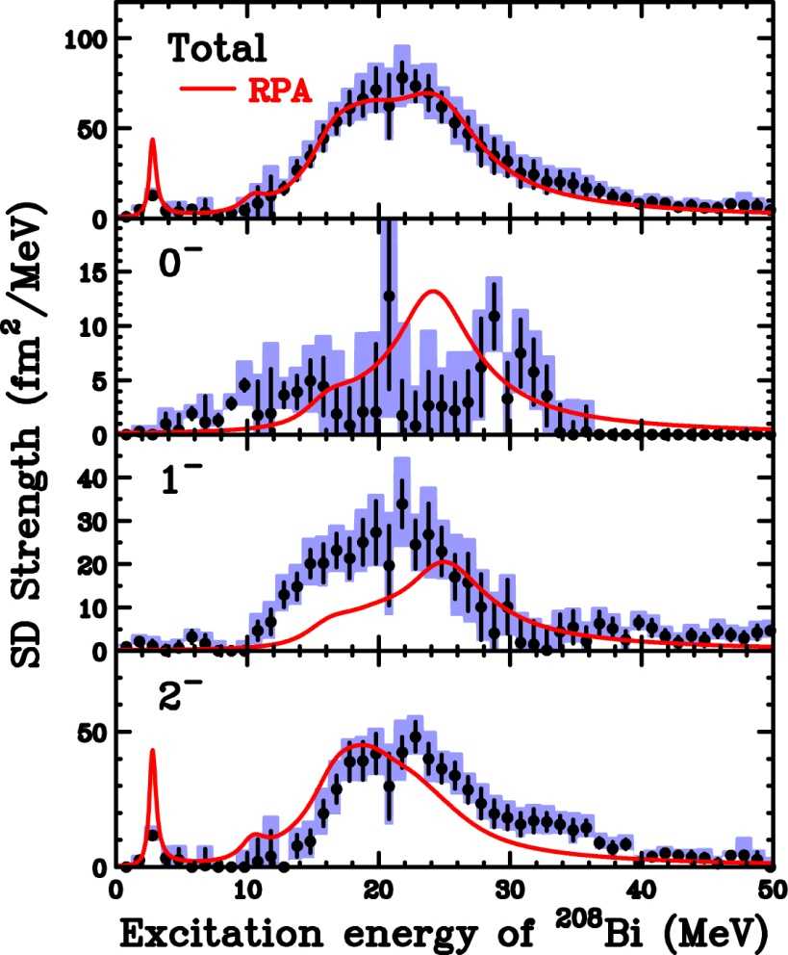
SD Strength Distributions ～Comparison with RPA～
Experimental B(SD)
Asymmetric single peak for 1⁻ & 2⁻
Tail to higher E_{x} up to 40 MeV
Fragmented 0⁻ strength
Theoretical calc. in RPA
Phenomenological spreading width
Effective inclusion of 2p2h (in part)
Strength distribution
Total strength is consistent
0⁻ strength is severely fragmented
Sequence of SDR peak
Exp: E_{x}(2⁻) ～ E_{x}(1⁻) ～ E_{x}(0⁻)
Theory: E_{x}(2⁻) < E_{x}(1⁻) < E_{x}(0⁻)
Comment on tensor correlations
Repulsive effect on 1⁻ : N.G. (attractive effect ? )

Slide 16
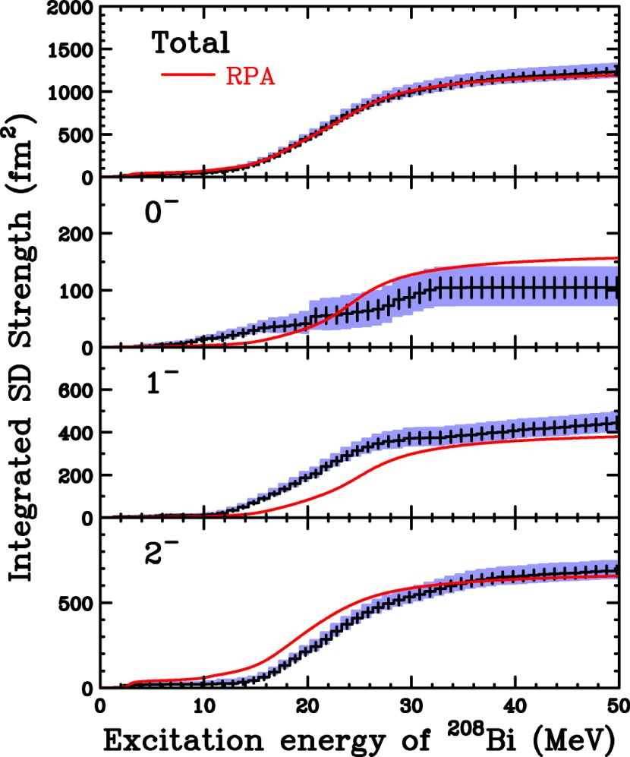
Integrated SD Strength ～Comparison with RPA～
Experimental B(SD) from MDA
Uncertainties
: Statistical uncertainty
: MDA uncertainty
～10% systematic uncertainty from σ_{SD}
Comparison with RPA
0⁻ : Slightly small (NOT significant)
1⁻ : Consistent (Softened)
2⁻ : Consistent (Hardened)
Total : Consistent (Similar distribution)
SD strengths are NOT quenched
SD distribution of each J^{π} is different from theoretical predictions
J^{π} decomposition in MDA with polarization data is successful

Slide 17
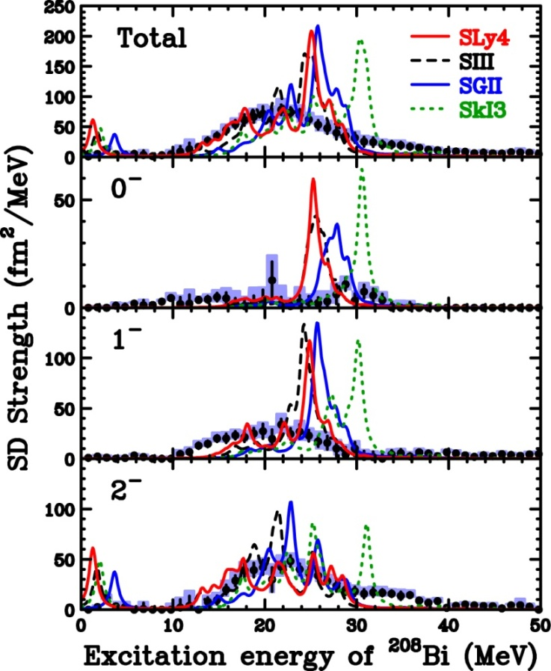
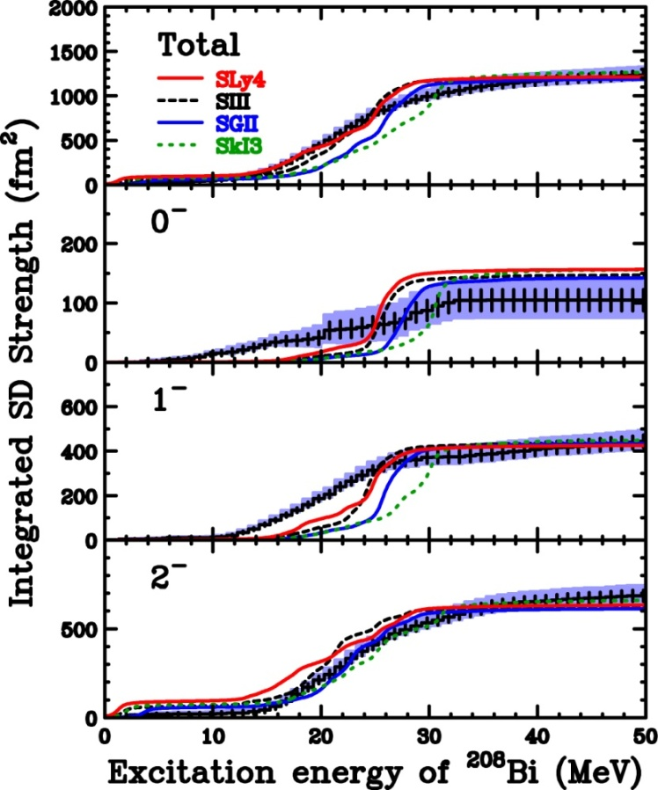
Comparison with HF+RPA
HF+RPA calculations by Sagawa-san’s group
Skyrme interaction: SLy4, SIII,SGII,SkI3
0⁻ and 1⁻ strengths are smeared/fragmented compared with calc.
1⁻ strength is significantly softened
Integrated strengths (each J^{π},Total) are consistent

Slide 18
Summary for GT/SD strengths of Stable Nuclei
Gamow-Teller strength
Peak position → g’_{NN} ～ 0.60
Strength (quenching) → g’_{NΔ} ～ 0.35
Pionic correlations at large q are also reproduced with these g’
Spin-Dipole strengths
Total SD strengths are well reproduced with present g’ values
Spin composition (0⁻,1⁻,2⁻) seems to be different
Extension to GT/SD strengths of unstable nuclei
MDA would be unsuccessful due to poor statistics
GT/SD strength without MDA ?
Physical background in cross section
Connection from cross section to GT/SD strength
Can DWIA reproduce absolute values of cross sections?
YES → Strengths could be deduced from cross sections
Predictions for Zr and O isotopes

Slide 19
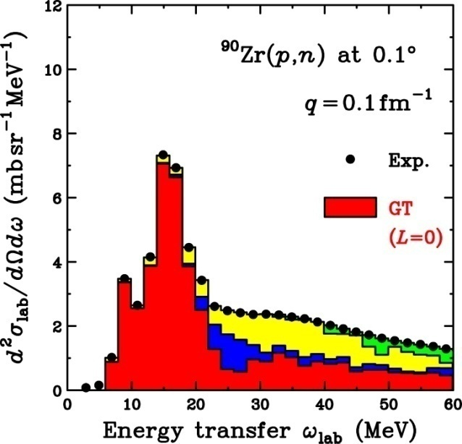
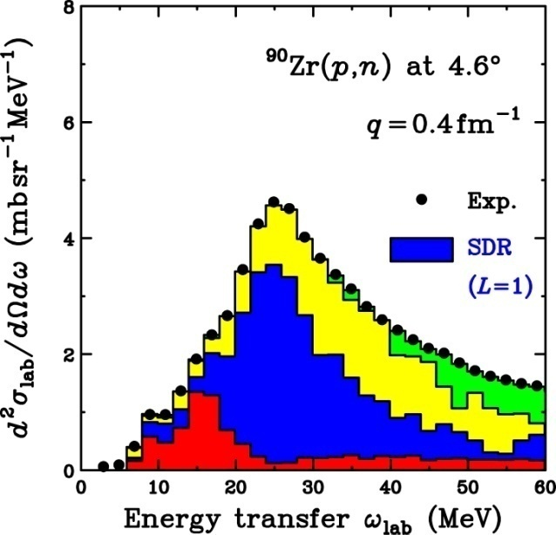
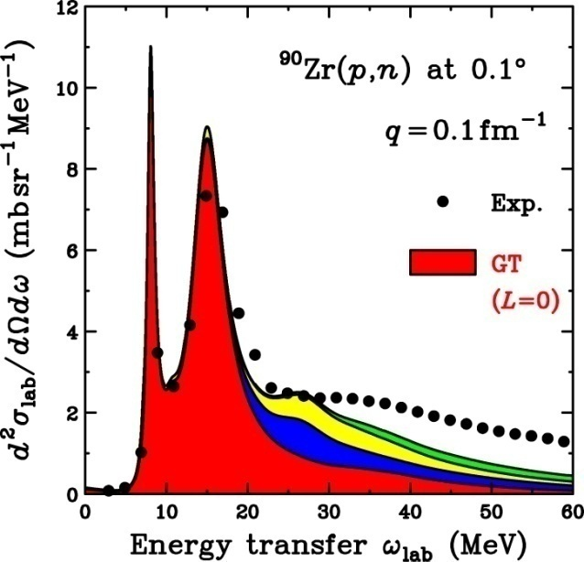
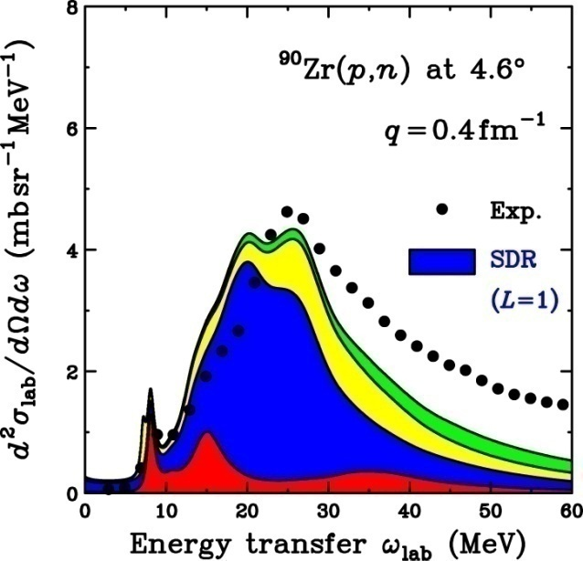
Comparison with MDA and DWIA for ⁹⁰Zr(p,n)
MD vs. DWIA
Consistent
B(GT) and B(SD) can be deduced
Negligible 2p-2h effects at ≦ 30 MeV
GT
Negligible B.G. (L≧1) in GTGR
B(GT) can be deduced w/o MDA (Not S(GT))
SD
Small (10-20%) BG in SDR
B(SD) would be deduced w/o MDA with ～10% error
MDA
DWIA

Slide 20
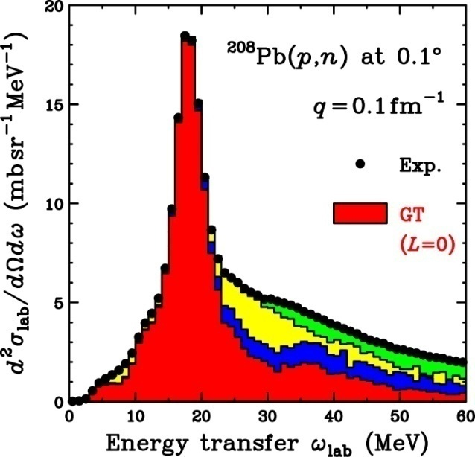
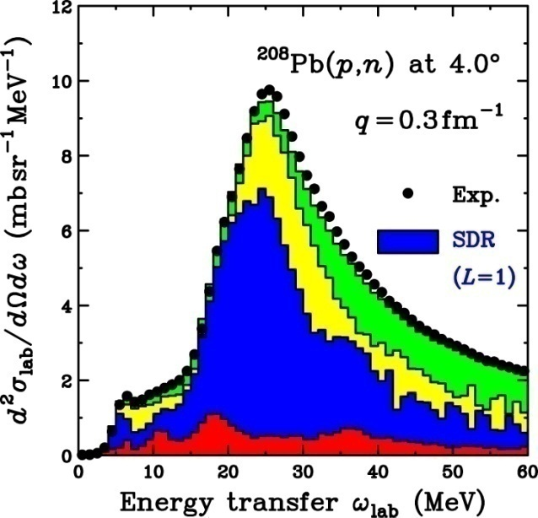
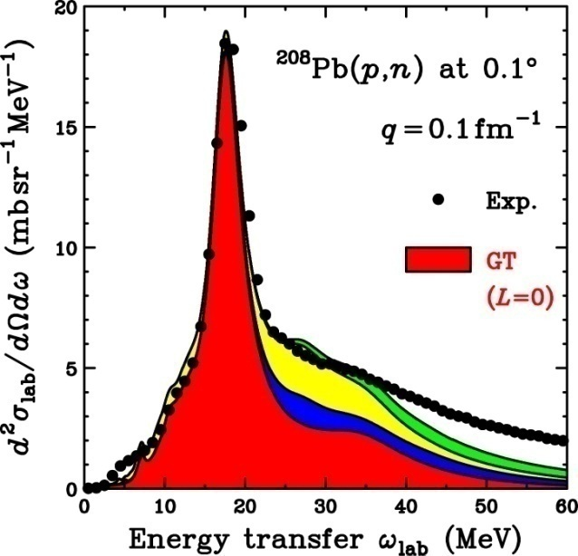
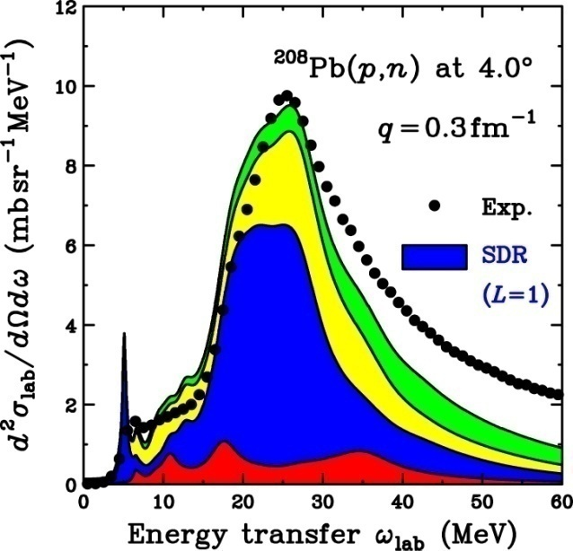
Comparison with MDA and DWIA for ²⁰⁸Pb(p,n)
MD vs. DWIA
Consistent
B(GT) and B(SD) can be deduced
Negligible 2p-2h effects at ≦ 30 MeV
GT
Negligible B.G. (L≧1) in GTGR
B(GT) can be deduced w/o MDA (Not S(GT))
SD
Small (10-20%) BG in SDR
B(SD) would be deduced w/o MDA with ～10% error
MDA
DWIA

Slide 21
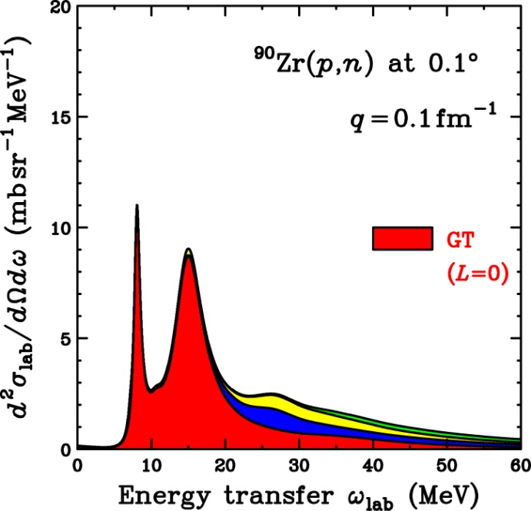
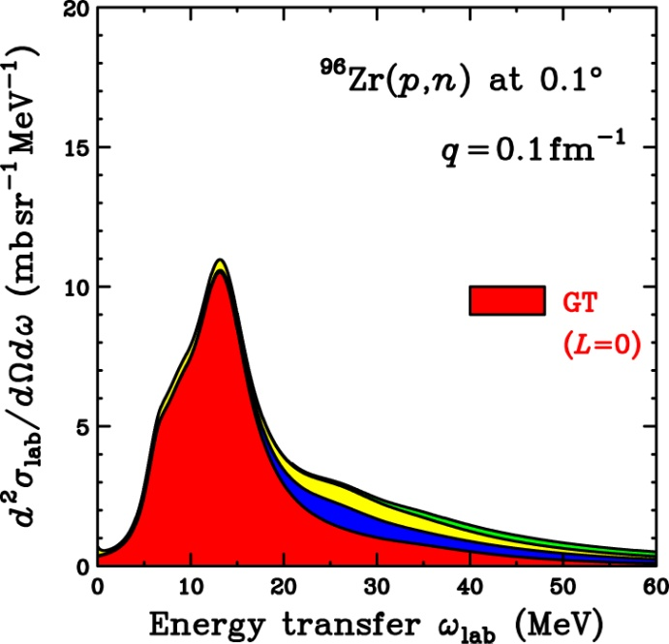
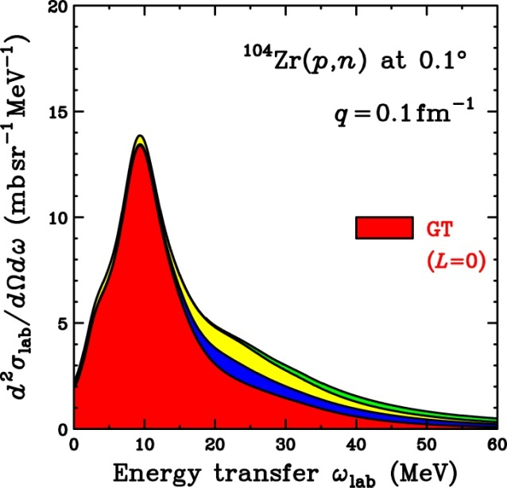
Isotope Dependence of GT for Zr
Excess neutron effects on GTR
⁹⁶Zr : d_{5/2} hole states fill the valley → GT states form a single resonance peak
¹⁰⁴Zr : Lower GTR peak position → Due to lower proton single particle states (Larger binding energy for protons)
Information on s.p. states is important for investigating correlation effects
15 MeV
15 MeV
15 MeV
d_{5/2} hole
⁹⁰Zr
g_{9/2} filled
⁹⁶Zr
d_{5/2} filled
¹⁰⁴Zr
g_{7/2} filled

Slide 22
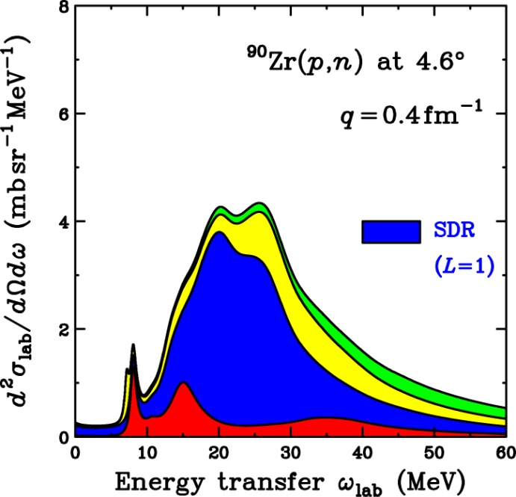
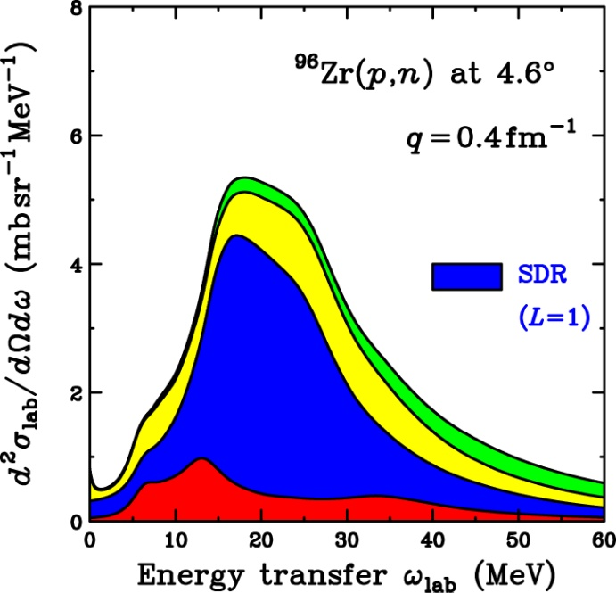
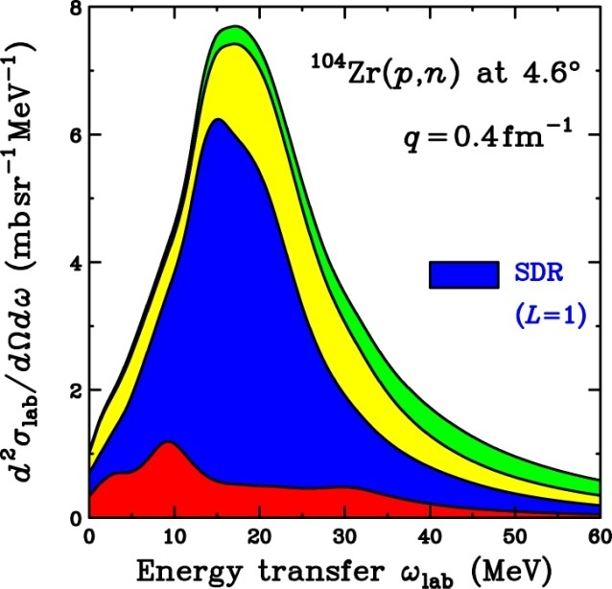
Isotope Dependence of SD for Zr
Excess neutron effects on SDR
SDR strengths are increased as a function of (N-Z)
SDR peak positions are lowered due to lower proton s.p. energy
SDR strengths could be deduced by using a proportionality ansatz
Neutron skin thickness might be deduced
SDR distributions would give information on interaction beyond π+ρ+g’
⁹⁰Zr
g_{9/2} filled
⁹⁶Zr
d_{5/2} filled
¹⁰⁴Zr
g_{7/2} filled

Slide 23
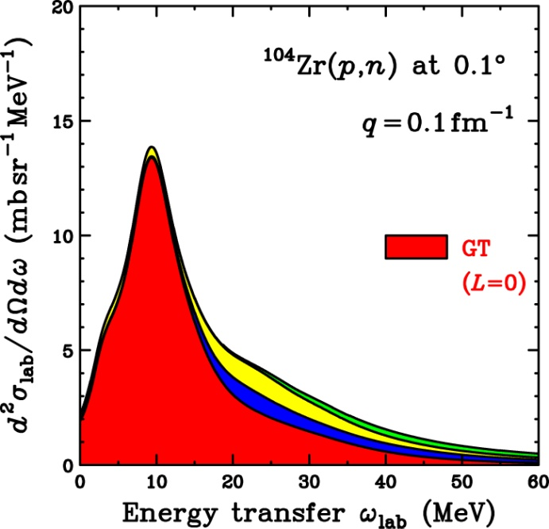
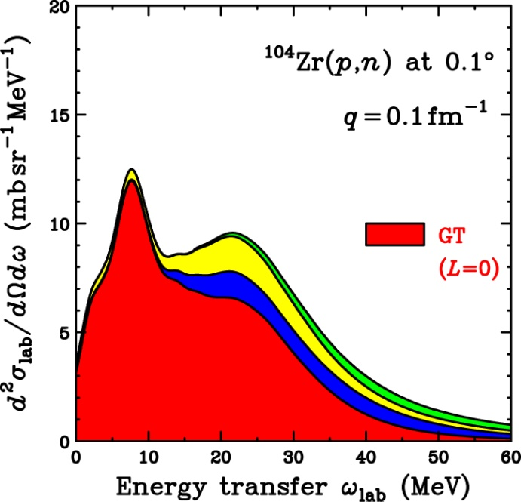
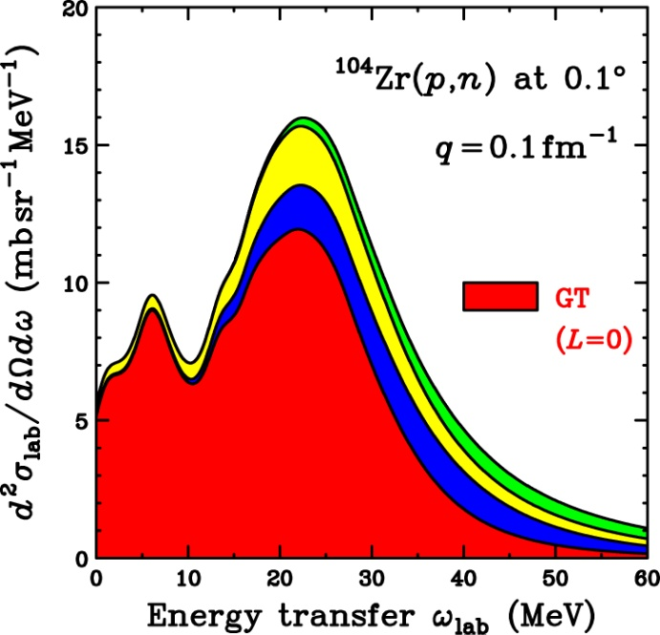
Neutron Skin Dependence of GT for ¹⁰⁴Zr
Neutron skin effects on GT/IVSM
GT : Peak height would be lowered (Interference by IVSM (?))
IVSM : Very sensitive to neutron skin thickness
IVSM would be CLEARLY observed for RI with neutron skin
IVSM strength is sensitive to neutron skin thickness
Peak energy ω～20 MeV (Very low compared with stable nuclei)
r_{n} = r_{p}
r_{n} = 1.1×r_{p}
r_{n} = 1.2×r_{p}

Slide 24
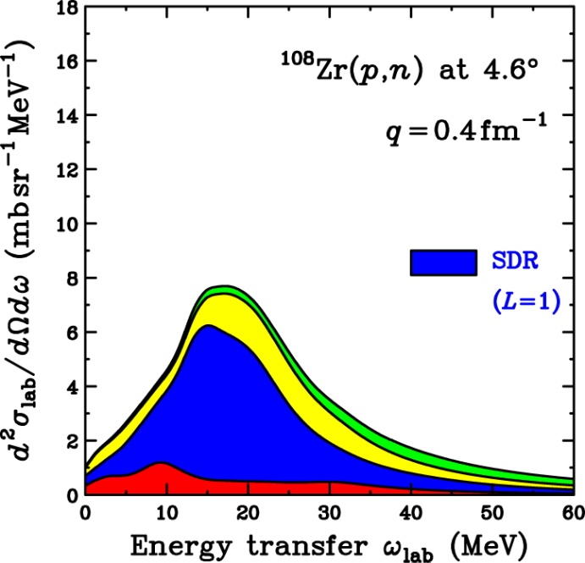
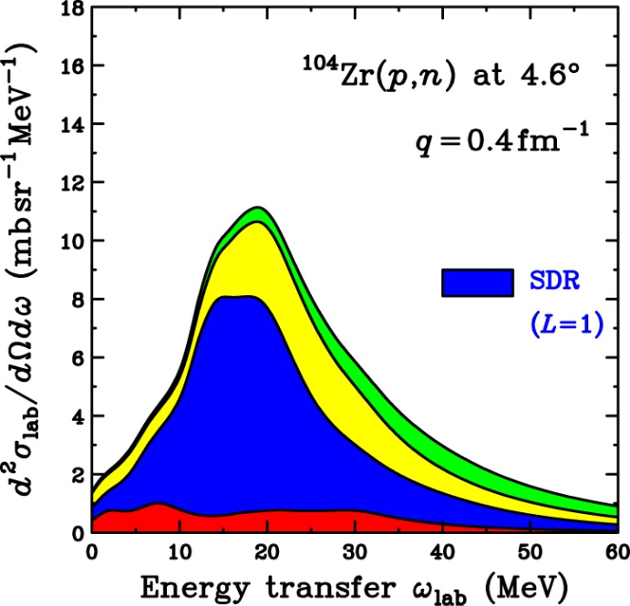
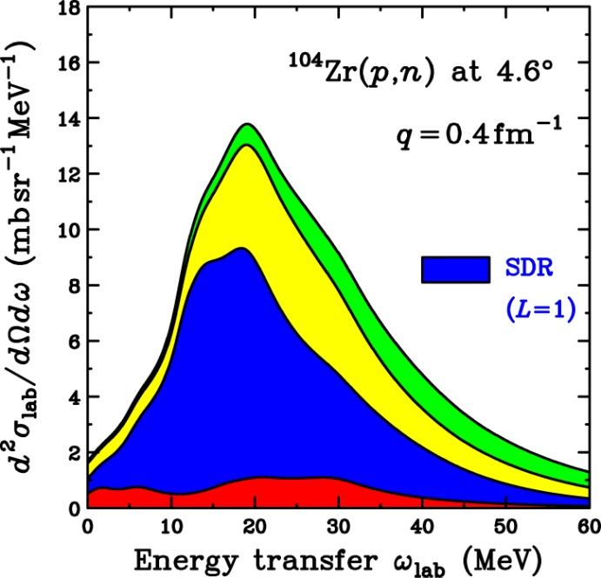
Neutron Skin Dependence of SD for ¹⁰⁴Zr
Neutron skin effects on SDR
SDR strengths are increased as a function of N<r_{n}²>-Z<r_{p}²>
Neutron skin effects are NOT so large
Effects are comparable with uncertainty of proportionality ansatz
Systematic studies would be required to deduce the neutron skin effects
Compare with the data for normal nuclei/isotope without neutron skin
r_{n} = r_{p}
r_{n} = 1.1×r_{p}
r_{n} = 1.2×r_{p}

Slide 25
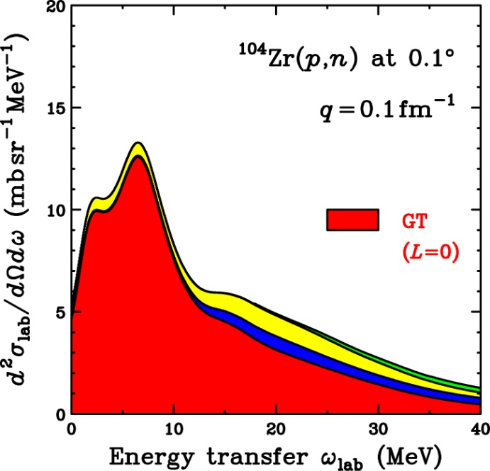
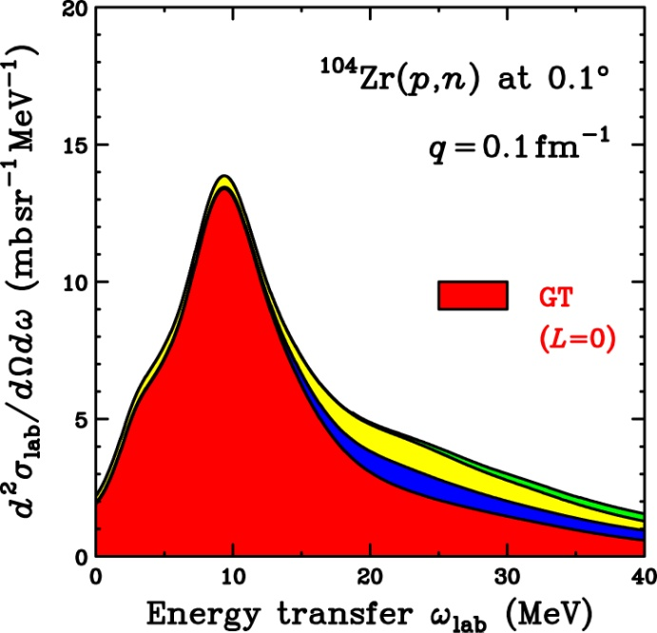
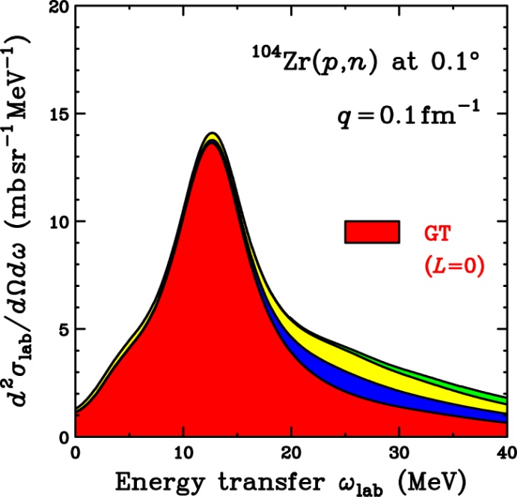
g’_{NN} Dependence of GT for ¹⁰⁴Zr
g’_{NN} dependence for GTR
GT strength is hardened as a function of g’_{NN}
GT strength is ALSO a function of neutron skin thickness
IVSM is sensitive to neutron skin thickness
GTR peak position is NOT sensitive to neutron skin thickness
Simultaneous measurement of GT and IVSM enables us to obtain
Information on g’_{NN} (nuclear correlation), and
Information on neutron skin thickness, independentluy
10 MeV
10 MeV
10 MeV
g’_{NN} = 0.3
g’_{NN} = 0.6
g’_{NN} = 0.9

Slide 26
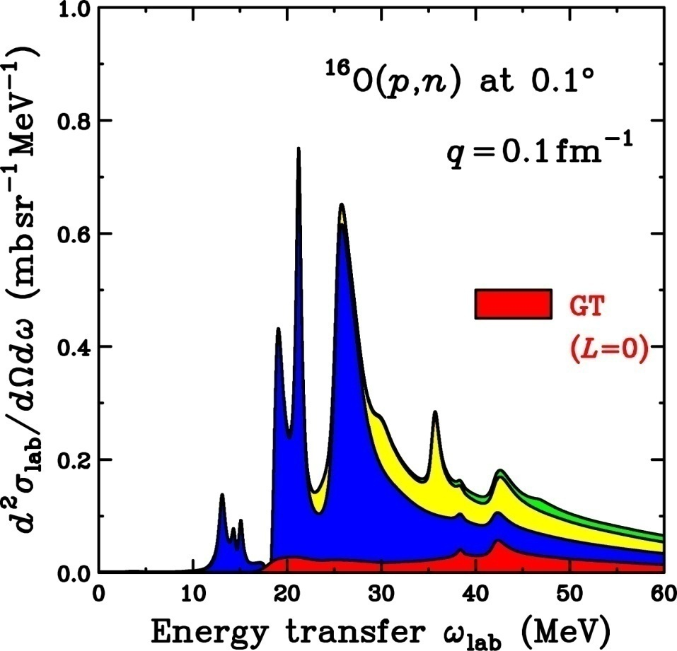
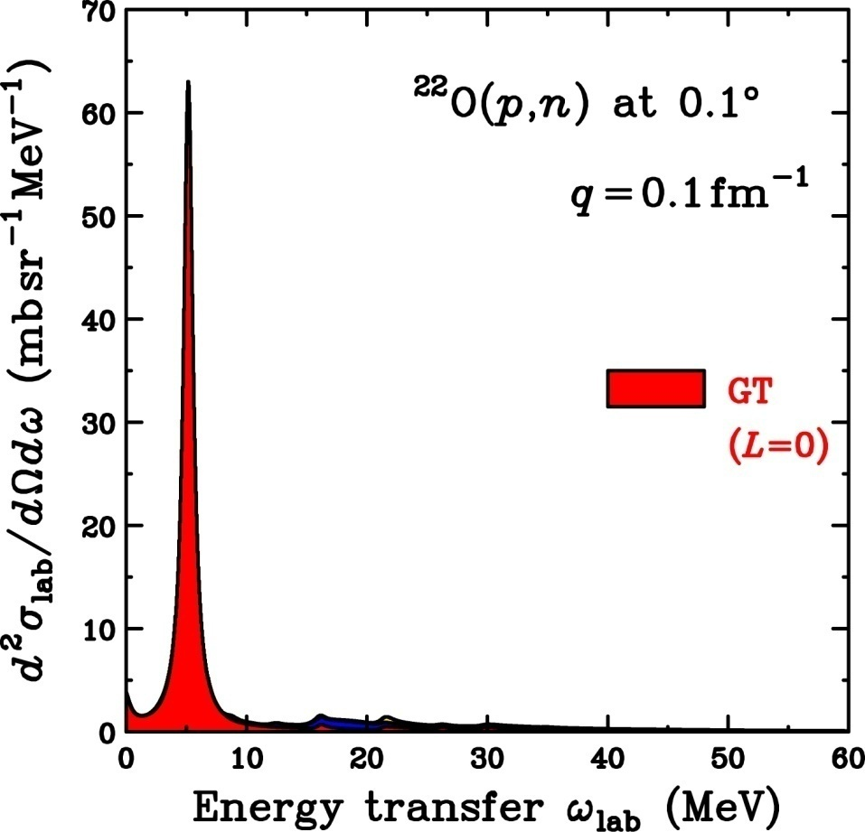
Isotope Dependence of GT for O
Excess neutron effects on GT
¹⁶O : GT strength is almost completely suppressed
²²O : Prominent GT peak (d_{5/2} hole) is expected
Should be checked by comparing sophisticated calc. (S.M. etc.)
¹⁶O : p_{1/2} filled
²²O : d_{5/2} filled

Slide 27
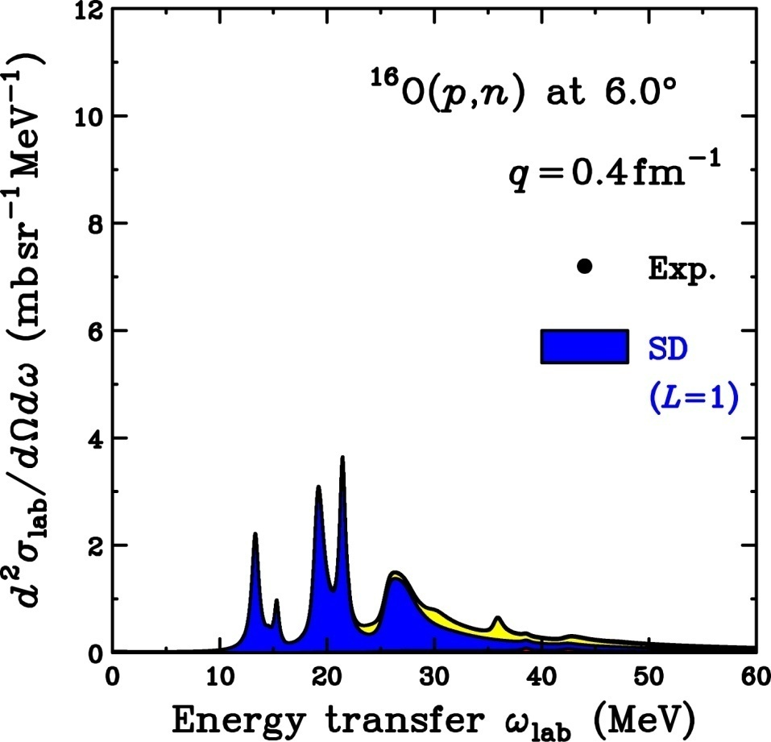
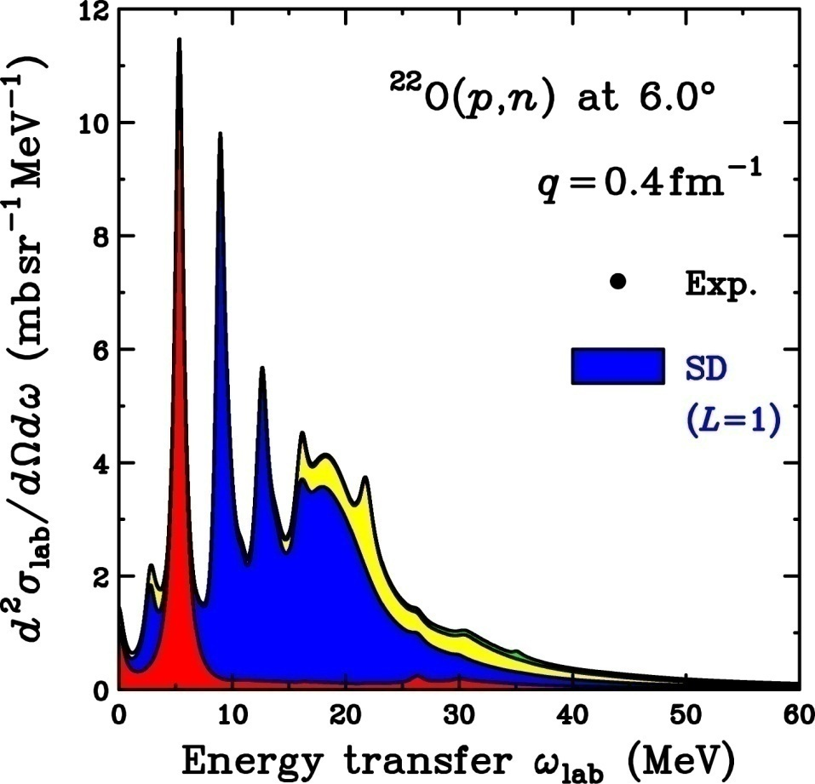
Isotope Dependence of SD for O
Excess neutron effects on SDR
SDR strengths are increased as a function of (N-Z)
Effects are significant compared with Zr due to larger N/Z
Neutron skin effects would be more clearly observed
SDR peak positions are lowered due to lower proton s.p. energy
20 MeV
20 MeV
Factor of 2
¹⁶O : p_{1/2} filled
²²O : d_{5/2} filled

Slide 28
Summary for Future Perspective
Proportionality ansatz for deducing GT/SD strengths
Reliable at E/A～300 MeV within ～10%
Physical background for deducing GT/SD strengths
Less than 10-20% in p-h region (≦30%)
Uncertainty of strength ～ 10-20% without MDA
MDA should be performed for total strength S
Prediction for Zr
Excess neutron effects would be observed in GT peak
Excess neutron effects would be observed in SD strength
IVSM would be clearly observed for nuclei with skin
Prediction for O
Excess neutron effects would be more clear compared with Zr
Comment
Elastic scattering data are important for reliable DW calculations
Information on s.p. levels is important for correlation effects

Slide 29
Backup

Slide 30

GT and IAS
ΔE=2MeV

Slide 31

Summary and Future Perspective
First attempt to perform MDA with polarization data
Successful separation of SDR into each J^{π} component
Information on SD strengths
SD strengths are NOT quenched
0⁻ strength : Fragmented
1⁻ strength : Softened (Inconsistent with tensor effects)
2⁻ strength : Roughly consistent
Perspective (In Progress)
MDA with “complete” polarization data
0⁻,1⁻,2⁻ Separation becomes more reliable
We can check the reliability of MDA
RCNP-E317 : ¹²C(p,n)¹²N
Complete polarization data at 0°,2°,4°6°,9°,12°(6 angles)
M. Dozono (Doctor work)
Spin-longitudinal
Spin-transverse
1⁺
2⁻
2⁻
0⁻
2⁻
1⁻
2⁻
Establish method of J^{π} decomposition in continuum by polarization data

Slide 32

Comment on GDR
Experimental GDR strength
γ absorption
GDR is dominant
E_{x} ～ 14 MeV
Γ ～ 4 MeV
RPA calculation
NO free parameter
f is determined by IAS
Phenomenological spreading width
(p,n) and (γ,n) difference is properly taken into account
Proportionality ansatz
σ_{abs} = 18×B(GDR)
S.N.Belyaev et al., Yad. Phys. 55, 289 (1992).
GDR strength is well described by RPA
→In MDA, GDR (non-spin) component can be fixed to RPA(γ-abs. data)

Slide 33

Previous Studies of SDR
Theoretical predictions
2p2h effects in 2nd-order RPA (SRPA)
Smear out RPA distributions
Move strengths to higher energies
Smearing effects are relatively small in 2-
2- has large config. compared with 0- and 1-
2- strength is fragmented in RPA(1p1h)
0- and 1- strengths → 2p2h effects

Slide 34


Results of MDA for ²⁰⁸Pb(p,n)
GTGR
2.3°
4.0°
1⁺(GT)
SDR
SDR
0⁻(SDR)
1⁻(SDR)
2⁻(SDR)

